Slide 1
CS 4530 Software Engineering
Module 14: Continuous Development Processes
Adeel Bhutta, Jan Vitek and Mitch Wand
Khoury College of Computer Sciences
Khoury College of Computer Sciences © 2023 released under CC BY-SA

Slide 2
Learning objectives for this lesson
By the end of this lesson, you should be able to…
Describe how continuous integration helps to catch errors sooner in the software lifecycle
Describe the benefits of a culture of code review
Describe strategies for performing quality-assurance on software as and after it is delivered

Slide 3
Continuous Development
Improving quality & velocity with frequent, fast feedback loops
Notes:
Continuous development aims to help us achieve better code quality (fewer bugs, or at least reduce their impact) and development velocity (get features out to customers faster) by creating frequent, fast feedback loops at each stage of the development process. Continuous development encourages us to perform frequent integrations, merging changes into our entire codebase, and running integration-scale tests frequently. Key to continuous development is frequent integration and deployment of our product
Continuous development represents a process like agile, but distinguished by frequent feedback, which aims to help us to “shift left”. Whereas in a traditional development process, we might integrate all of our changes and perform end-to-end tests (and deployments) on a weekly or monthly basis, continuous development argues for faster feedback loops: integrate your code hourly and deploy multiple times a day.

Slide 4
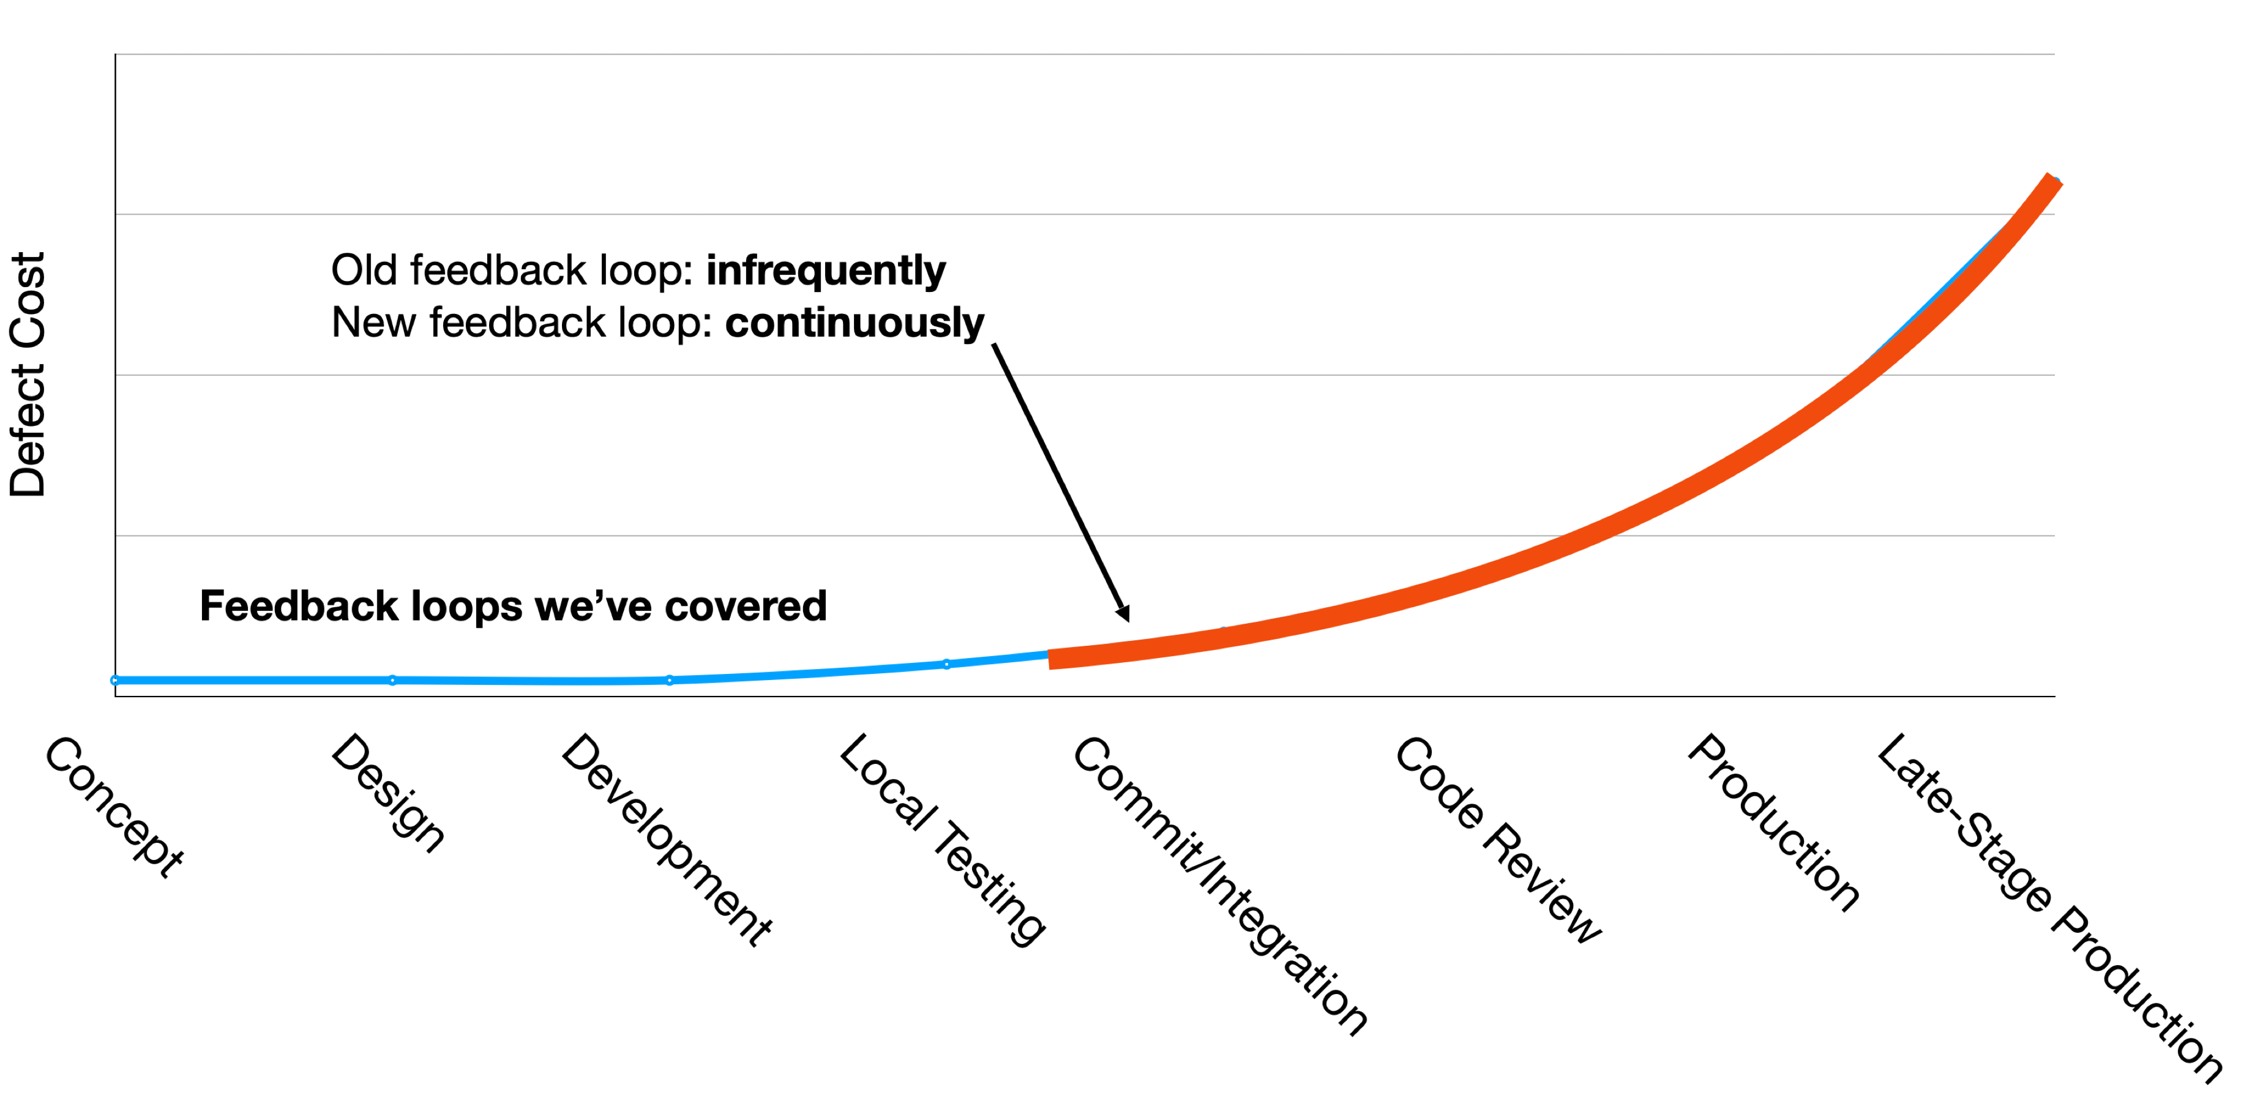
Agile values fast quality feedback loops
Faster feedback = lower cost to fix bugs
Notes:
So far, we have talked about different approaches for finding bugs faster during development: ensuring that our requirements are correct, doing TDD, unit testing, starting to write integration and end to end tests… but there is also a long road from writing some code to our product being a success.
So far, we have stressed approaches that aim to make it easier to find bugs faster (click to show build over left side of curve). The intuition behind this is that the sooner we find something wrong (and fix it), the less wasted effort we will spend building other things that are also wrong.
Why expensive as move to the right?
Need to be triaged by someone who doesn’t know (or doesn’t remember)
Might now need more work, since code has changed around the bug
Has a greater impact - who wants to read about their bug on the front page of the newspaper?
This lesson: continuous integration and development. What kind of feedback loop can we put to find more bugs faster before deploying to production.
We’ve seen so far: The edit-compile-debug loop of local development, automated test results to a code change when you run it locally
Now consider:
An integration error between changes to two projects, detected after both are submitted and tested together (i.e., on post-submit) An incompatibility between our project and an upstream microservice dependency, detected by a QA tester in our staging environment, when the upstream service deploys its latest changes
We will also consider:
Bug reports by internal users who are opted in to a feature before external users
Bug or outage reports by external users or the press

Slide 5
Continuous Integration
Fast feedback on integration errors
CI automates large test suites
Notes:
The first process that we’ll talk about is called “continuous integration”

Slide 6
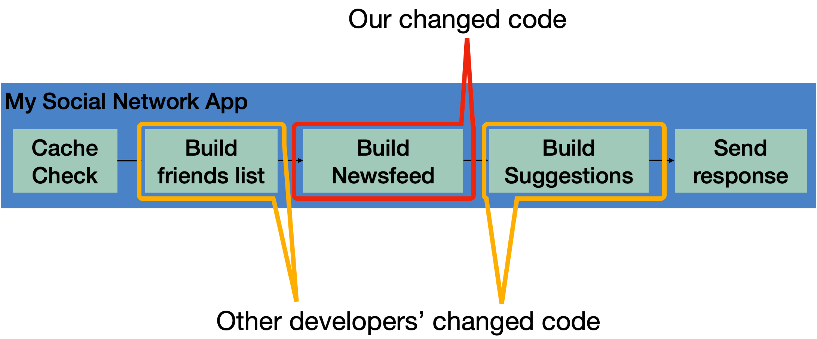
Continuous Integration
Motivation
Our systems involve many components, some of which might even be in different version control repositories
How does a developer get feedback on their (local) change?
Notes:
Continuous integration is particularly relevant in software that involves multiple components. A developer might change code in one component, say, the code that handles building the newsfeed that will show up in the returned page. This might live in one repo, and be an independent component. However, this component is part of a bigger, overall application, which consists of other components: the newsfeed probably depends on other components (like that which builds a friends list), and there might be other components that depend on the newsfeed (like something that builds a list of suggestions). There might be even more complex interactions with other components: like perhaps before sending a response back to a client, the server will save the response into a cache, and on repeated requests, that cache is served. There might be other changes going on, too - other developers are likely working on changing other components at the same time. Traditional waterfall or even agile development processes often involve performing integrations between all of these changes infrequently - perhaps weekly or monthly. The idea behind continuous integration is to integrate these changes and test them rapidly - as soon as they are created.

Slide 7
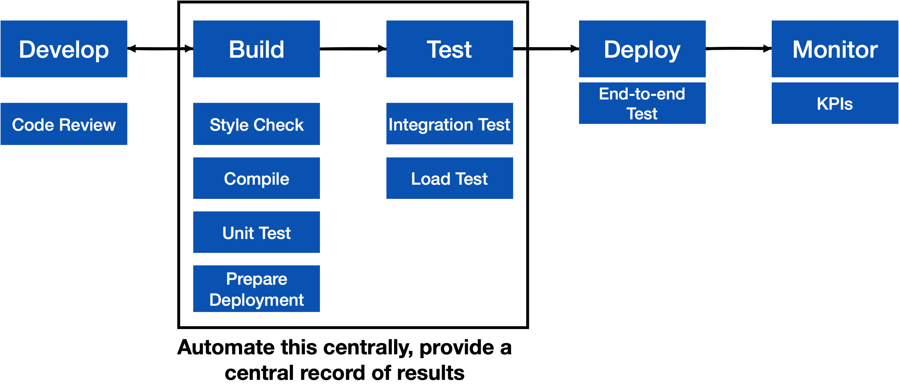
CI is a software pipeline
Notes:
So, the core to continuous integration is to centrally and automatically execute these development processes, regularly.
With CI, we continuously assemble and test changes to our codebase. By performing these integrations quickly and frequently, we can get faster feedback, and hence, “shift left” - allowing bugs to be detected sooner. There’s an enormous difference in how long it takes to debug something if you detect the bug immediately after writing the code versus even, say, the next day - let alone after several weeks.
CI processes are software pipelines. Recall from our discussion of software architectures that “pipeline” systems are good for building systems that have a specific order of operations, with dependencies between some steps. CI workflows follow this pattern: some steps depend on others (can’t test until you build), but many steps might be possible in parallel (run many different kinds of tests concurrently)

Slide 8
CI in practice
Small scale, with a service like CircleCI, GitHub Actions or TravisCI
GitHub
commits code to
checks for updates
Developer
GitHub Actions
TravisCI
CircleCI
Runs build for each commit
Notes:
Run an entire test suite on each commit, or perhaps do other things. Each commit triggers some workflow to run, and we can customize that workflow to do anything from building our code, to running tests, to deploying infrastructure.

Slide 9
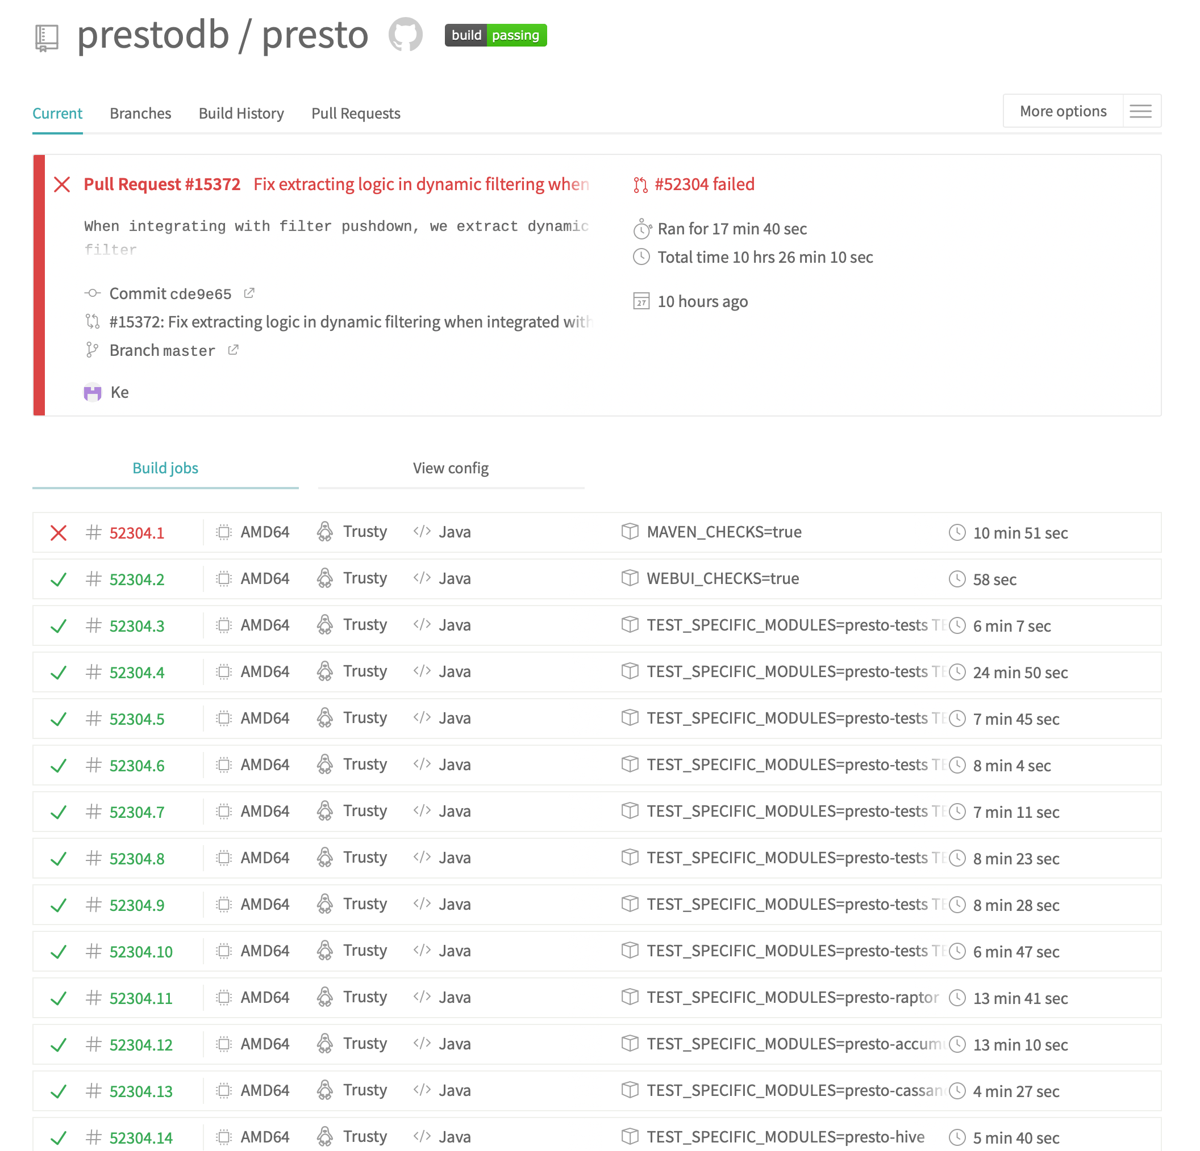
Example CI Pipeline
Open source project: PrestoDB
https://travis-ci.com/github/prestodb/presto
Notes:
Here’s a screenshot of a continuous integration pipeline from an open source project, Facebook’s presto database.
Point out: Run on pull request, runs multiple jobs

Slide 10
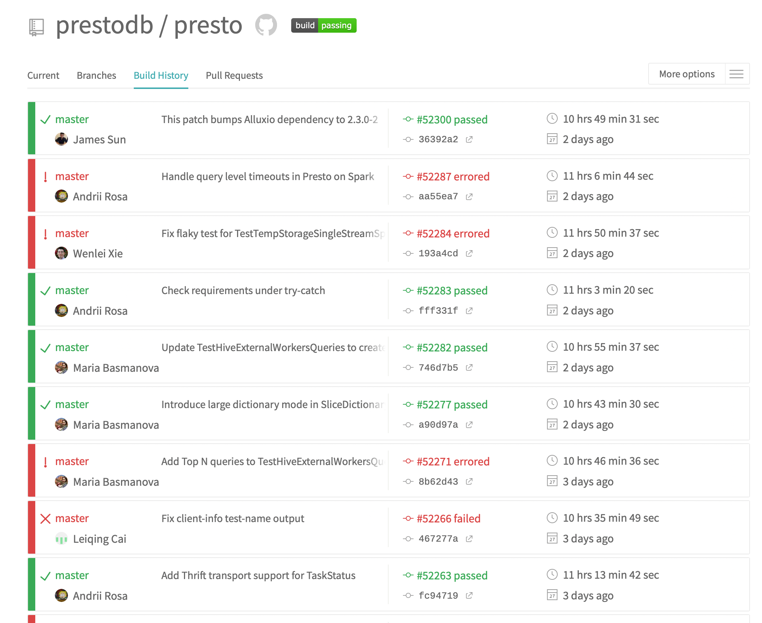
Example CI Pipeline - TravisCI
At a glance, see history of build
https://travis-ci.com/github/prestodb/presto
Notes:
Here’s another view of that same project’s CI pipeline: here we can see the history of each build. From this view, any developer can answer the simple question: “when did a test break? What fixed it?”

Slide 11
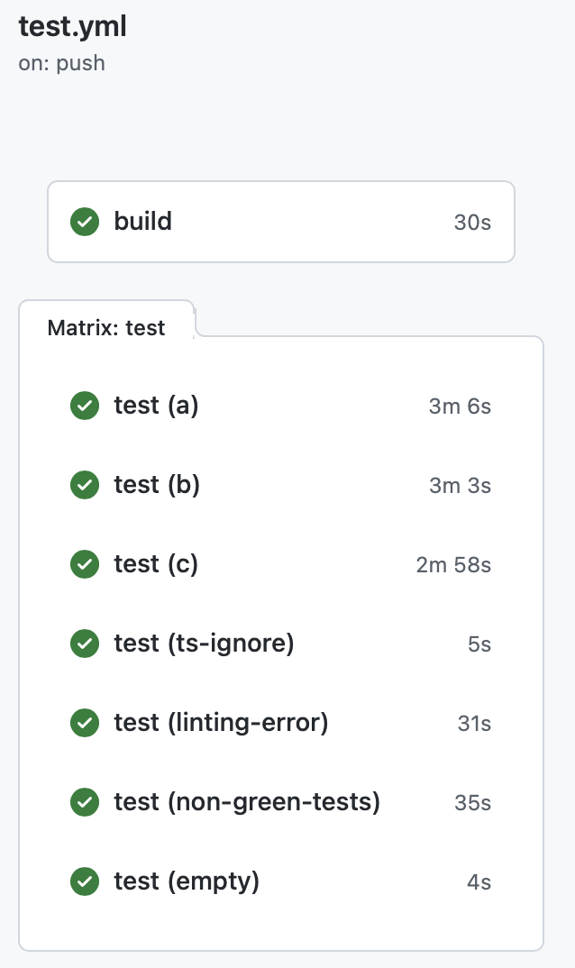
CI In Practice: autograder
test.yml (CI workflow file)
GitHub Actions Results
name: 'Build and Test the Grader'
on: # rebuild any PRs and main branch changes
pull_request:
push:
branches:
- main
- 'releases/*'
jobs:
build:
runs-on: self-hosted
steps:
- uses: actions/checkout@v2
- uses: actions/setup-node@v2
with:
node-version: '16'
- run: |
npm install
test:
runs-on: self-hosted
strategy:
matrix:
submission: [a, b, c, ts-ignore, linting-error, non-green-tests, empty]
steps:
- uses: actions/checkout@v2
- uses: actions/setup-node@v2
with:
node-version: '16'
- uses: ./
with:
submission-directory: solutions/${{ matrix.submission }}
Notes:
By “Test”, we don’t just mean running Jest tests. A CI workflow consists of a set of “jobs”, which are simply scripts, in this case, written in a mix of Bash and TypeScript.
Here is a workflow that we use to test changes in the autograder – the grader is automatically executed in a clean environment on various representative submissions
On the left, we can see the workflow that is run every time that we push a commit to the repository that hosts the IP autograder.
This workflow is triggered on any pull request on the repo, or on any push to the branch “main” or a branch that is prefixed with “releases/”.
There are two kinds of jobs: build, and test. Both run on our self-hosted github actions environment (runs-on), but there could be other values here to specify, say, an OS version to use.
The steps to build the project are to: 1. Check out the project, 2. setup nodeJS version 16, and 3. install it. If any of these steps fail, then the job fails, and we would see a red X in our build result.
Then, there is a job “test”, which in this case we allow to start running immediately (no dependency on build). The test job is parametrized over an array called “submissions”, which defines various example test suites that we test the autograder on with every commit (in GitHub Actions terminology, this is called a ‘build matrix strategy’). The test step also checks out the code, and also sets up NodeJS, and then it runs the autograder. The autograder is implemented in TypeScript as a GitHub Action itself, so we invoke it by telling GitHub to use the action defined in this repository (./), passing the spectiic submission directory that should be used to execute the autograder.
This workflow allows us to get very fast feedback on changes to the grading scripts – the grader is automatically executed in a clean environment on various representative submissions, and it can all happen in parallel.

Slide 12
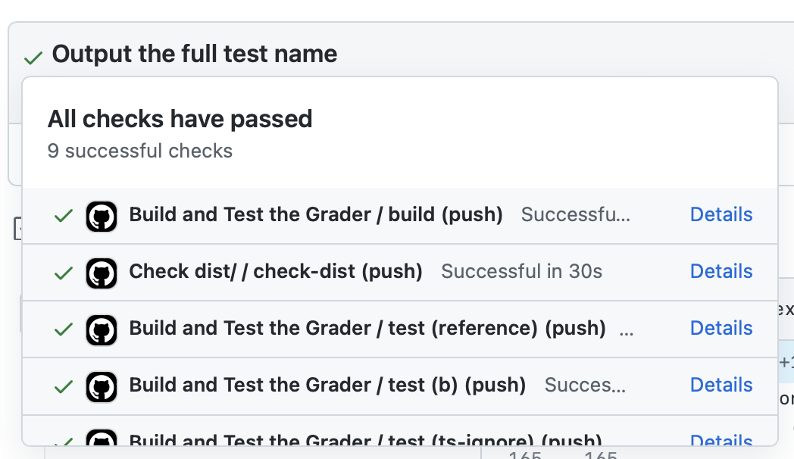
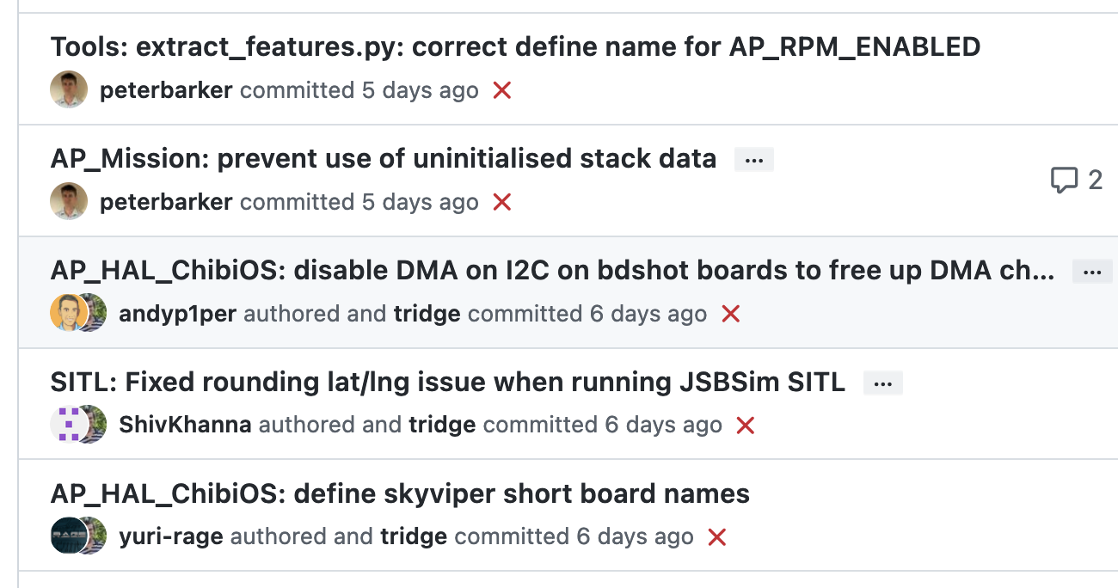
Attributes of effective CI processes
Do not allow builds to remain broken for a long time
CI should run for every change
CI should be fast, providing feedback within minutes or hours
CI should not completely replace pre-commit testing

Slide 13
How do we apply continuous integration?
Testing the right things at the right time
Do we integrate changes immediately, or do a pre-commit test?
Which tests do we run when we integrate?
How do we compose the system under test at each point?
Changed code
My Social Network App
Cache Check
Build friends list
Build Newsfeed
Build Suggestions
Send response
Other developers’ changed code
Notes:
Immediately/pre-commit: small project with a few commits a day and a test suite under 30 mins, probably integrate immediately and run full test suite. But: consider our social network app, where we might have 20 changes/hour and a 30 mins test suite, when do you choose to integrate things? Do we wait for last integrated change to pass before integrating next?
Which tests to run - again, easy on small. But: what if our big social network app: we probably should also run tests that could depend on this (like other components of our request pipeline). At the limit: maybe now our new newsfeed change will impact how the request caching feature works, and we should check that too. Do we check everything?
How do we compose system under test - do we use mocks for external services, or do we use production, or do we make a special environment for each integration test?
We’ll look at a few examples

Slide 14
Use scalable cloud resources for CI
Example: Developing a Fuzzer
Fuzzers automatically generate inputs to programs that cover code and reveal bugs
Fuzzers are non-deterministic: to evaluate with confidence, need repeated, long-running trials
Evaluating fuzzers is time consuming, determining which changes impact performance is confusing
How to run experiments in the cloud?

Slide 15
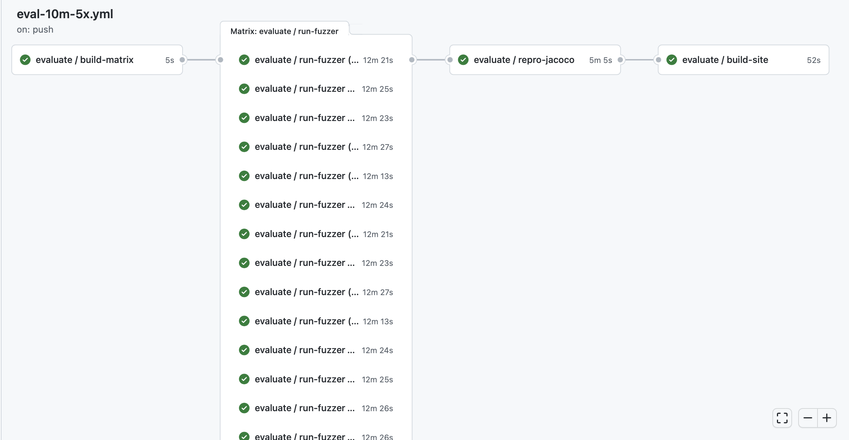
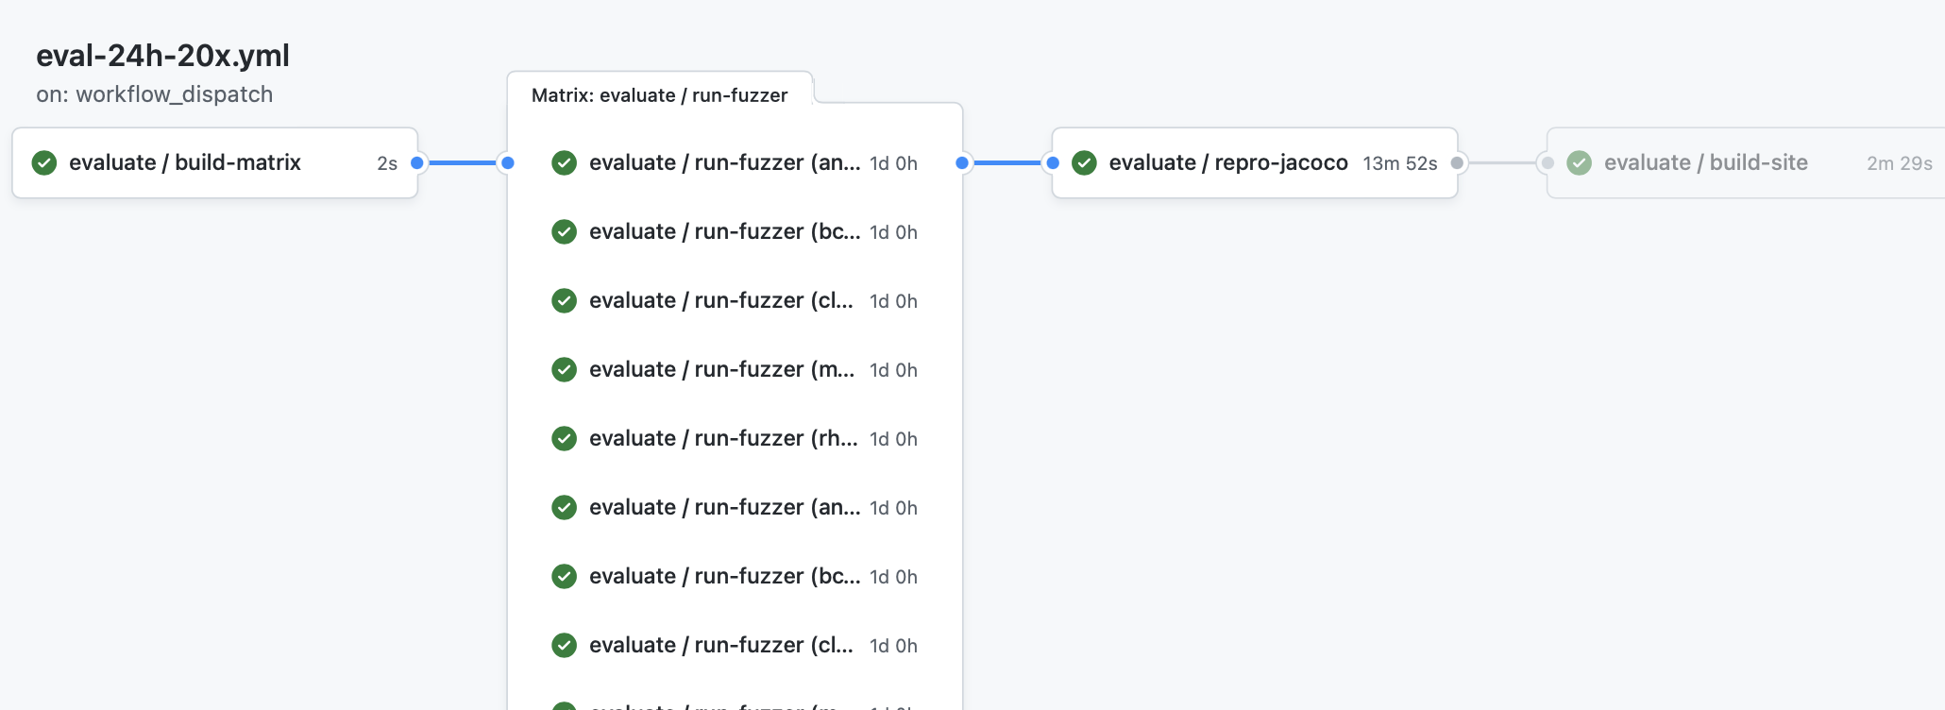
CI Pipelines automate performance testing
Every commit: Run 10 minute performance test on 5 benchmarks, repeating each test 5 times (25 concurrent jobs)
On Demand: Run 24 hour performance test on 5 benchmarks, repeating each test 20 times (100 concurrent jobs)
https://github.com/neu-se/CONFETTI/actions
Notes:
These screenshots show the graphical summary of two CI pipelines set up for this fuzzer.
The top one shows a workflow that can run on every commit, providing useful feedback on performance and correctness in about 15 minutes: running a 10 minute performance test on 5 benchmarks, repeating each one 5 times (25 concurrent jobs needed)
The bottom one shows a workflow that runs only upon request, which performs a much more thorough evaluation: 20 repetitions of 5 benchmarks, with each running for 24 hours.
In both cases, there are 4 jobs defined: 1. build the matrix (run a script that will determine which benchmarks to run), 2. (in parallel) run the fuzzer on those benchmarks, 3. collect all of those results and reproduce them for later analysis, and 4. render a report into markdown and HTML that summarizes the results

Slide 16
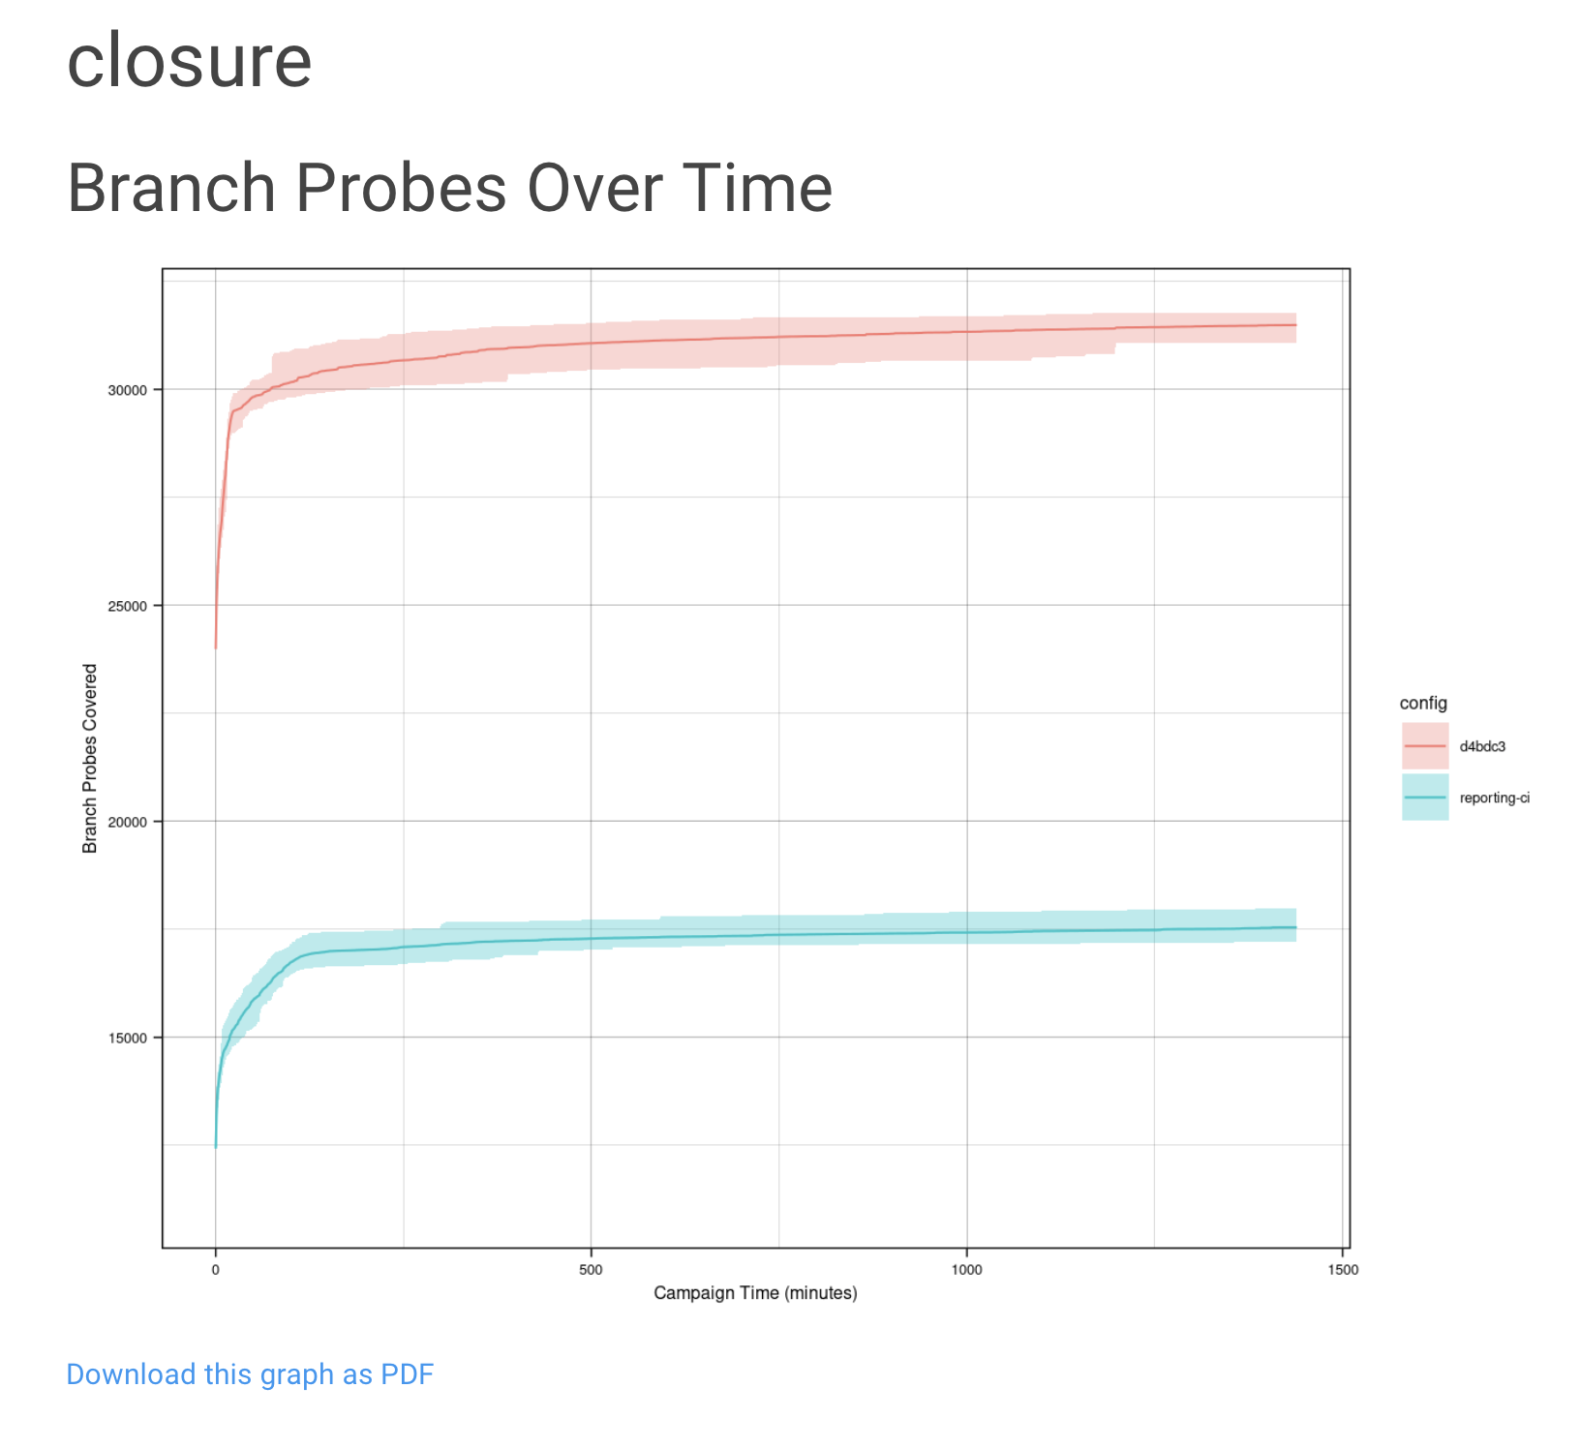
CI Pipelines automate benchmarking
On Demand: Run 24 hour performance test on 5 benchmarks, repeating each test 20 times (100 concurrent jobs)
https://github.com/neu-se/CONFETTI/actions
Notes:
Automating this kind of performance testing lets us get feedback much faster than if we had to do it manually. It also allows us to have a centralized repository of those results, so that we can track performance over time.
Here is an example of one of the graphs that get output from the report.
“branch probes over time” is one of the key performance indicators that fuzzers like this one are evaluated on. Since all of the data is centrally stored, it is easy to automate reports like this that compare the performance on the current commit to, say, another branch. This graph shows in red the current commit, and in blue, the main development branch.

Slide 17
CI in practice
Large scale example: Google TAP
50,000 unique changes per-day, 4 billion test cases per-day
Pre-submit optimization: run fast tests for each individual change (before code review). Block merge if they fail.
Then: run all affected tests; “build cop” monitors and acts immediately to roll-back or fix
Build cop monitors integration test runs
Average wait time to submit a change: 11 minutes
“Software Engineering at Google: Lessons Learned from Programming Over Time,” Wright, Winters and Manshreck, 2020 (O’Reilly)
Notes:
Google Test Automation Platform

Slide 18
Cost to fix a defect over time
Rough estimate
Code Review is a process of
reading and commenting on code
Notes:
The next process that we will discuss is code review, which is a process that takes place when introducing new code into a shared repository.
We can’t use CI to automatically detect all errors - for at least some, we will need to rely upon humans. Code review is a process of reading and commenting on code, and is usually performed only after a successful CI run.

Slide 19
Code review should be a formal process
A code review is the process in which the code’s author explains it to peers:
What should it do?
How does it do it?
How confident are we in it?
What are results of running tests?
A code review often concerns a code change (“diff”)

Slide 20
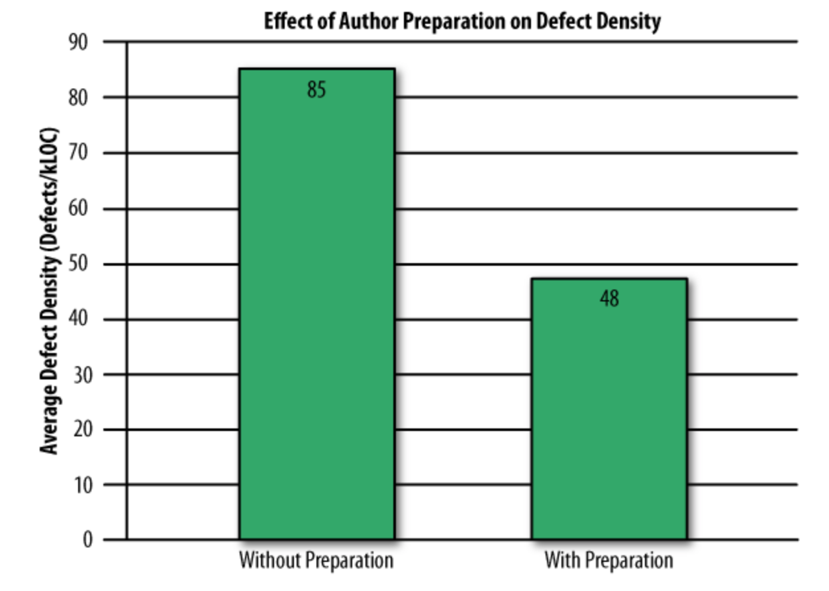
Self-review is no substitute for peer review
Study of 300 reviews at Cisco in 2006
Even if developers pre-review their code, many defects still found in peer review
“Best Kept Secrets of Peer Code Review”, Jason Cohen, SmartBear Software, 2006
Notes:
This study compared efficacy of code reviews where the authors claim to have previously reviewed the code (“with preparation”) vs. those where authors do not claim they have done a self-review (“without preparation”). Even if developers pre-review their code, many defects were still found in the peer review.

Slide 21
Code Review vs Code Inspection
Formal process of reading through code as a group;
Applied to all project documents;
A 3-5 person team reads the code aloud and explains what is being done;
Each person has a specific role (moderator, reviewer, reader, scribe, observer, author)
Usually a 60 minute meeting;
Less efficient (defects/cost) than modern review processes.
Very waterfall.
Traceable, measurable
Notes:
A formal code inspection is a heavyweight process, usually called for by strict standards and there’s a detailed paper trail to be produced. Might still be performed in high-assurance domains like avionics (?).
We will concentrate on code review, not code inspection.

Slide 22
Why should we perform code review?
Code review increases breadth of knowledge of code:
Other people ”know” the code
Easier to handle someone cycling off project
Verbalizing decisions improves their quality:
The process of writing an explanation encourages critical thinking
Code reviews improve quality of code base:
Knowing code is reviewed pushes devs to make it more presentable and understandable
Notes:
Discussion Question: Who should do a code review? Internal or external people?

Slide 23
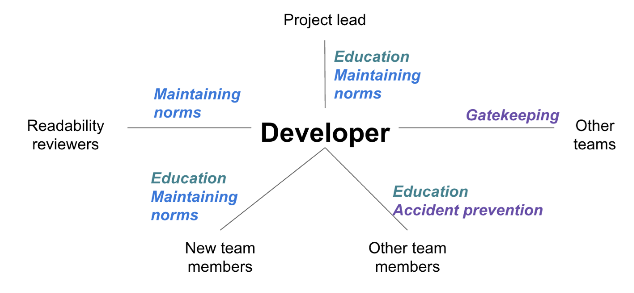
Many stakeholders can benefit from code review
Reviewers might be…
An owner of the code being changed or added to
Someone to verify that the code meets standards.
Someone to ensure documentation is consistent.
Other people interested in this code base or experts
“Modern Code Review: A Case Study at Google”, Sadowski et al, ICSE 2018
Notes:
(Figure on right shows the different roles of team members in black, with the benefits/goals of each reviewer in colors)
<Discussion question: which of these do you think is most important? Why?

Slide 24
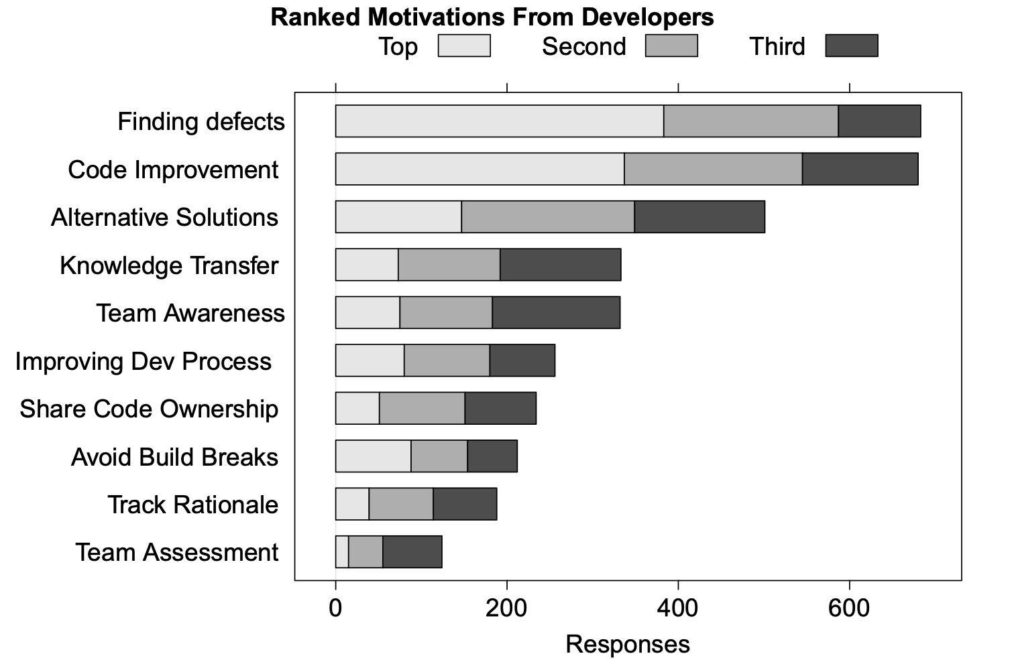
Code reviews have many benefits
“Expectations, Outcomes, and Challenges of Modern Code Review”, Bacchelli & Bird, ICSE 2013
Notes:
Here’s what a survey of developers thought were the major benefits of code review.
Code reviews are also helpful for checking quality attributes that are hard to automatically check such as: security, compliance, and scalability. (This might be covered under “code improvement”, but we’d have to go back and look at the original study to know for sure.)

Slide 25
Code review: How they do it at Google
At Google, reviewers get changes, explanation and all test results: review is asynchronous.
Elsewhere reviews can be in person:
More heavyweight, cannot be as common.
Review must be professional and impersonal:
No one is being “attacked” (or, no one should be).
Don’t rehash design arguments (defer to author).
All suggestions and criticisms must be addressed:
At least in the negative.
Notes:
How can we get the benefits of code reviews as our project (and our teams) scale up?
Here is how they do it at Google. Why Google?– because they are Very Large, and because they are public about their processes (unlike many other large shops).
<Read Slide>

Slide 26
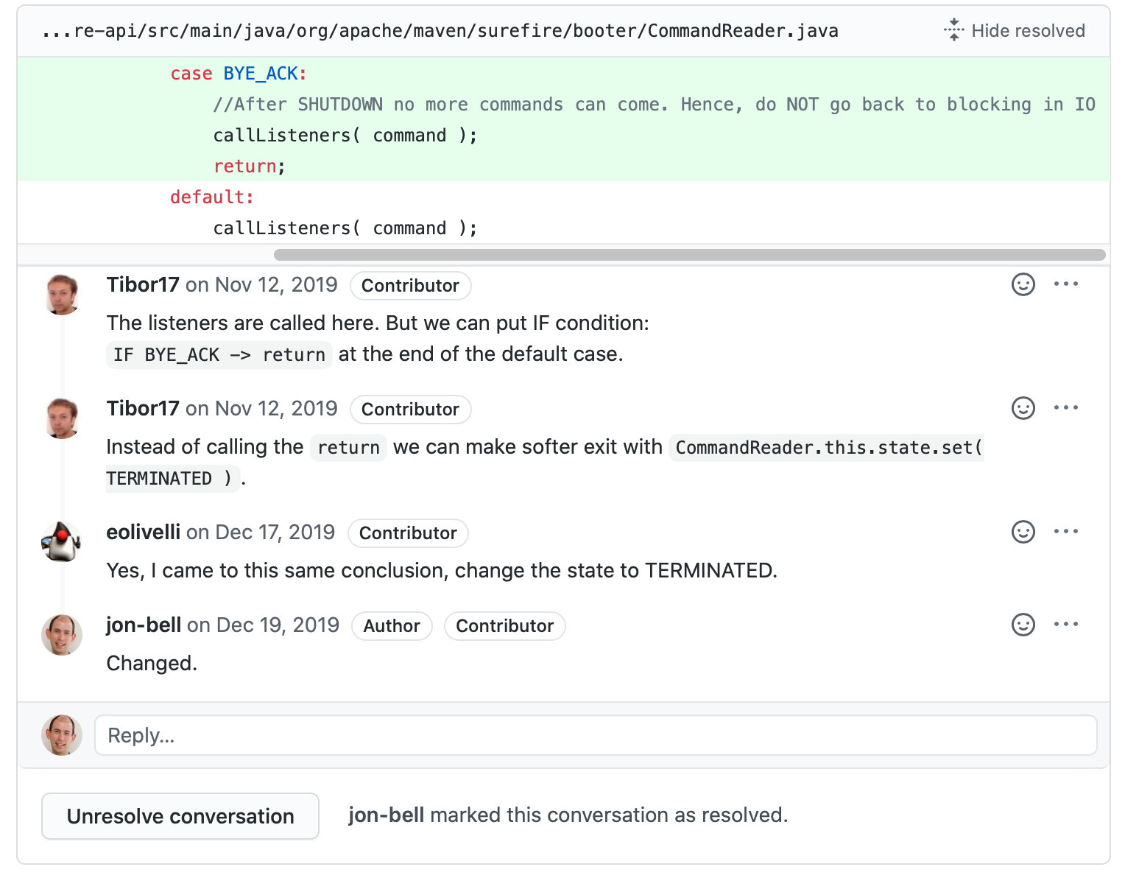
Code review: example on pull request
Notes:
Here’s an example of a code review on a pull request. The pull request model encourages project maintainers to review a pull request (patch) being submitted. Code review interfaces like GitHub’s make clear who is the author of the code, and who is otherwise a contributor to the repository.
This is the kind of thing we expect to see happening in your team projects.

Slide 27
Code review checklist
Consider:
Am I able to understand the code easily?
Does the code follow our style guidelines?
Is the same code duplicated more than once?
Is this file (or change) too big?
Does this code meet our non-functional requirements?
Is this code maintainable?
Does this code have unintended side-effects?

Slide 28
Code Reviews and Programmer’s Ego
Remember:
Code review means someone’s looking over your work
You might have some attachment to it
Criticisms: sometimes hard not to take personally
Acknowledge a criticism and move on
Acknowledgment doesn’t imply that the author agrees with the content of the criticism
The review is not about you, the goal is to improve code

Slide 29
Cost to fix a defect over time
Rough estimate
The final quality frontier: testing and monitoring in production
Notes:
CI and code review can help us flatten this curve of defect cost over time. However, what do we do about defects that get into production code. For example, how do we decrease the cost to address:
Bug reports by internal users who are opted in to a feature before external users
Bug or outage reports by external users
Can we develop a process to detect these defects and resolve them before they have a greater impact?

Slide 30
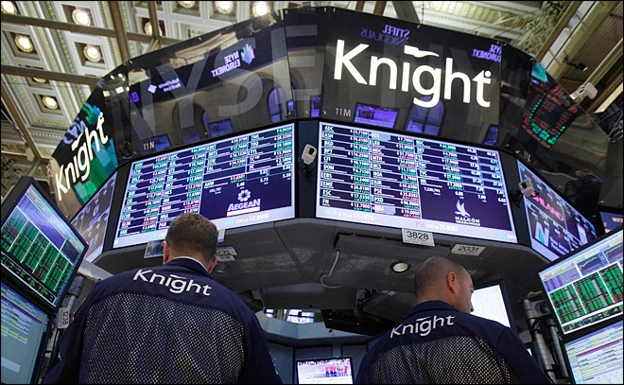
Case study of a failed deployment
“In the week before go-live, a Knight engineer manually deployed the new RLP code in SMARS to its 8 servers. However, he made a mistake and did not copy the new code to one of the servers. Knight did not have a second engineer review the deployment, and neither was there an automated system to alert anyone to the discrepancy. “
https://www.henricodolfing.com/2019/06/project-failure-case-study-knight-capital.html
Notes:
The short of it:
Built a new trading system, created a system for testing that would attempt to drive prices up or down (at a significant loss per-transaction) in order to test system responses to market conditions
Had to manually deploy the new code to some servers…
Did not remove the testing code (“power peg”) from one of the eight
In first hour of trading the system bought $7 billion of stocks (money that Knight didn’t have)
No planned processes to monitor the deployed system or to roll back to a working one (they actually made it worse while trying to fix it, restoring the “power peg” testing code on all remaining servers - why not just shut the whole thing down?)
Goldman Sachs quite generously bailed out Knight capital, buying the $7b position for a $440m discount

Slide 31
What could Knight capital have done better?
Use capture/replay testing instead of driving market conditions in a test
Avoid including “test” code in production deployments
Automate deployments
Define and monitor risk-based KPIs
Create checklists for responding to incidents
Notes:
The Knight capital story is definitely an interesting one, and perhaps now that we have discussed some strategies for continuous deployment, it is hopefully somewhat clearer how this enormous financial loss could have been prevented.
First, some comments on the testing strategy:
Why, why why why is it a good idea to write a test case that actually tries to change market conditions, when you could instead test your code using simulated/historical market conditions?
Never include testing code in production deployments: that test code for changing markets in order to test the system response to them was included in the production code!?!
Then on the deployments:
If deployment were automated, there would not be a step for an engineer to miss on one of the 8 deployments: they could always happen predictably
There was insufficient monitoring. The way that this error was detected was the NYSE had noticed that market volume was more than expected, and then traced it back to Knight. Nobody at Knight had thought to create a dashboard that monitored their volume (and perhaps more importantly, financial exposure vs assets at hand). This could have been detected *immediately* and automatically paged the relevant people (and perhaps also automatically paused the firm’s trading activities). Seems like a reasonable investment.
There were no checklists for responding to incidents, and no procedures to roll-back if needed. “If in doubt back it out” was the Facebook philosophy, and it requires a process to be in place so that it can be easily triggered

Slide 32
Deployment Philosophy: Instagram
“Faster is safer”
“If stuff blows up it affects a very small percentage of people”
Instagram cofounder and CTO Mike Krieger
https://www.fastcompany.com/3047642/do-the-simple-thing-first-the-engineering-behind-instagram
Notes:
Mantra: “Doing the simple thing first”
Here’s another company that has been somewhat famous for its deployment philosophy. Why was Knight capital’s deployment error such a costly mistake? How could we have made it better?
Agile might suggest that we should embrace uncertainty. A deployment model that allows us to limit the impact of production bugs is probably a better model than one that tries to entirely prevent their introduction (and hence ignores the contingencies)

Slide 33
Continuous Delivery
“Faster is safer”: Key values of continuous delivery
Release frequently, in small batches
Maintain key performance indicators to evaluate the impact of updates
Phase roll-outs
Evaluate business impact of new features
Notes:
Thanks to the automated software integration pipeline that we’ve built, we can now work on closing the last feedback loop: by delivering our updates frequently, we can observe the impact of each update in relative isolation. We can be agile - releasing frequently, in small batches of updates. Thanks to automation from our CI + infrastructure system, we should be able to release with relatively low human overhead. We can maintain performance indicators like crashes, or latency and work on improving them. We can roll-out these changes to just a few users before shipping to everyone, and use this data to help determine if we should do that roll-out or not. We can even use this approach to evaluate whether newly designed features are used by users as our product designers intended - for instance, if we are implementing improvements to the usability of a commenting system, we might measure whether there are more comments made using the new feature or not. There are a few tricks that we can use to make this all work (and not make our software worse).

Slide 34
Staging environments
Enabling Continuous Delivery
As software gets more complex with more dependencies, it's impossible to simulate the whole when testing
Idea: Deploy to a complete production-like environment, but don't have all use it
Examples:
“Eat your own dogfood”
Beta/Alpha testers
Lower risk if a problem occurs in staging than in production
Notes:
A key pre-requisite for continuous delivery is a staging environment .(read slide)
Example: apple gives their employees iphone for testing. Slack/facebook employees are “forced” to be part of beta testing. We use internal developers to serve as testers.

Slide 35
Test-Stage-Production
Continuous Delivery in Action
Developer Environments
Beta/Dogfooding
User Requests
Testing Environment
Staging Environment
Production Environment
Revisions are “promoted” towards production
Q/A takes place in each stage (including production!)
Notes:
These different deployment environments create a “deployment pipeline”, where code changes get “promoted” from one level of deployment to the next.
The “testing environment” is perhaps the developers’ local machines, and provides a reasonable baseline for running tests, but it would be hard to have many other users be testing our software from that one developer’s computer, and it also would probably be hard to setup ALL of the services necessary to really make a “deployment-like” environment on each developer’s local computer.
The “staging environment” is usually a production-like environment, consisting of all of the same services that are in production, but perhaps deployed at a smaller scale.
At each deployment step, there are extensive Q/A processes that help ensure confidence that the software is ready to ship.
Most continuous delivery pipelines involve at least these three phases, but in practice, there may be many staging environments, and several versions of the software deployed in production concurrently.

Slide 36
A/B Deployments with Canaries
Mitigating risk in continuous delivery
Monitor both:
But minimize impact of problems in new version
Notes:
Another typical strategy used in continuous delivery are A/B deployments. With A/B deploymernts, the production environment actually runs multiple versions of the code. Most users see the old version, but some users see the new version. Automated systems can monitor metrics from both deployments – all kinds of metrics, ranging from memory consumption to response time to overall user satisfaction. This approach might be called “testing in production” - and key to it is that even if a problem is detected in the new version, the user’s request could still be satisfied by the old version.

Slide 37
Operations Responsibility
DevOps in a slide
Once we deploy, someone has to monitor, make sure it’s running OK, no bugs, etc
Assume 3 environments: Test, Staging, Production
Whose job is it?
 | Developers | Operators
Waterfall
Agile
DevOps
Test
Staging
Production
Test
Staging
Production
Test
Staging
Production
Production
Notes:
The idea of “devops” is core to enabling this kind of deployment pipeline. In traditional “waterfall” models of software development, developers are responsible for one thing: writing the software. Not even testing it – you have a separate QA team, and you have a separate operations team.
In agile development, the developers will be responsible for writing (and running) their own tests, but it is not necessarily the case that developers are held responsible for operating the service. We might have a fully separate team responsible for that.
In “DevOps”, we create automated tooling to make it so that every developer can (in principle) be an operator of the software. If every developer is empowered with the ability to create their own staging environment on-demand, then we can scale this idea of continuous delivery up as we grow our development team.
This is not to say that there are no individuals who are dedicated to “operating” the software in deployment: these roles still certainly exist, and a common title might be ”site reliability engineer” – but just like developers are empowered in DevOps to deploy their own staging environments, operators are empowered to understand the software and debug infrastructure-related issues.

Slide 38
Release Pipelines
How quickly is my change deployed?
Even if you are deploying every day, you still have some latency
A new feature I develop today won't be released today
But, a new feature I develop today can begin the release pipeline today (minimizes risk)
Release Engineer: gatekeeper who decides when code ready to go out, oversees deployment process
Notes:
(read slide). Important bit is that there is latency to get to production – start dogfooding right away, but not release to public

Slide 39
Deployment Example: Facebook.com
Pre-2016
Developers working in their own branch
When feature is ready, push as 1 change to master branch
~1 week of development
~1 week of development
master branch
3 days
4 days
All changes that survived stabilizing
Stabilize
Release Branch
Weekly
All changes from week
that are ready for release
release branch
production
Your change doesn’t go out unless you’re there that day at that time to support it!
3x Daily
“When in doubt back out”
Notes:
https://engineering.fb.com/2017/08/31/web/rapid-release-at-massive-scale/
This chart shows the overall process that was used before 2016 to deploy Facebook.com. (read diagram; important bits: dev branches get merged into master, then once a week all changes from the past week are pulled into a release branch. For 3 days they “stabilize” the release branch – find changes that are causing very bad behavior and back them out. Then for the last 4 days of the week, every change that survived that stabilization gets individually pushed to production batched so that this happens 3x/day. Important to do small deploys so that you can isolate bad changes)
What was bad about this? Didn’t scale. How many changes going out? 500-700 PER DAY. By 2016 might be pushing 10k diffs per week. ENORMOUS effort to co-ordinate (between the “your change doesn’t go out unless you’re there to support it” and “when in doubt back it out” – both very manual)
(From the blog post):
For many years, we pushed the Facebook front end three times a day using a simple master and release branch strategy. Engineers would request cherry-picks — changes to the code that had passed a series of automated tests — to pull from the master branch into one of the daily pushes from the release branch. In general, we saw between 500 and 700 cherry-picks per day. Once a week, we’d cut a new release branch that picked up any changes that were not cherry-picked during the week.
By 2016, we saw that the branch/cherry-pick model was reaching its limit. We were ingesting more than 1,000 diffs a day to the master branch, and the weekly push was sometimes as many as 10,000 diffs. The amount of manual effort needed to coordinate and deliver such a large release every week was not sustainable.

Slide 40
Deployment Example
Chuck Rossi, Director Software Infrastructure & Release Engineering @ Facebook
“Our main goal was to make sure that the new system made people’s experience better — or at least, didn’t make it worse. After a year of planning and development, over the course of three days we enabled 100% of our production web servers to run code deployed directly from master”
“Rapid release at massive scale” https://engineering.fb.com/2017/08/31/web/rapid-release-at-massive-scale/
Notes:
So, Facebook re-architected their release process. (pause to read quote)

Slide 41
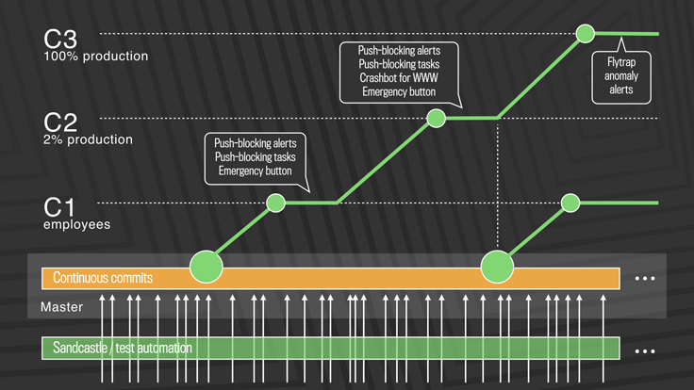
Deployment Example
Post-2016: Truly continuous releases from master branch
https://engineering.fb.com/2017/08/31/web/rapid-release-at-massive-scale/
Notes:
This approach solves the problem of scaling continuous delivery. In Facebook’s new deployment model, there is no manual cherry-picking, and there are automated processes to detect anomalies and revert changes. There are three-tiers of deployment, from C1 (dog-fooding/staging) to C2 (deployment to a small slice of production) to C3 (deployment to entirety of production workload)
The process works like this: (copied from blog post)
First, diffs that have passed a series of automated internal tests and land in master are pushed out to Facebook employees. In this stage, we get push-blocking alerts if we’ve introduced a regression, and an emergency stop button lets us keep the release from going any further. If everything is OK, we push the changes to 2 percent of production, where again we collect signal and monitor alerts, especially for edge cases that our testing or employee dogfooding may not have picked up. Finally, we roll out to 100 percent of production, where our Flytrap tool aggregates user reports and alerts us to any anomalies.
Many of the changes are initially kept behind our feature flags, which allows to roll out mobile and web code releases independently from new features, helping to lower the risk of any particular update causing a problem. If we do find a problem, we can simply switch the feature off rather than revert back to a previous version or fix forward.

Slide 42
Monitoring
The last step in continuous deployment: track metrics
Hardware
Voltages, temperatures, fan speeds, component health
OS
Memory usage, swap usage, disk space, CPU load
Middleware
Memory, thread/db connection pools, connections, response time
Applications
Business transactions, conversion rate, status of 3rd party components
Notes:
A key enabling technology for continues delivery is metric monitoring. There might be a wide range of metrics that we can monitor to gain insights into the performance characteristics of our application (read slide)

Slide 43
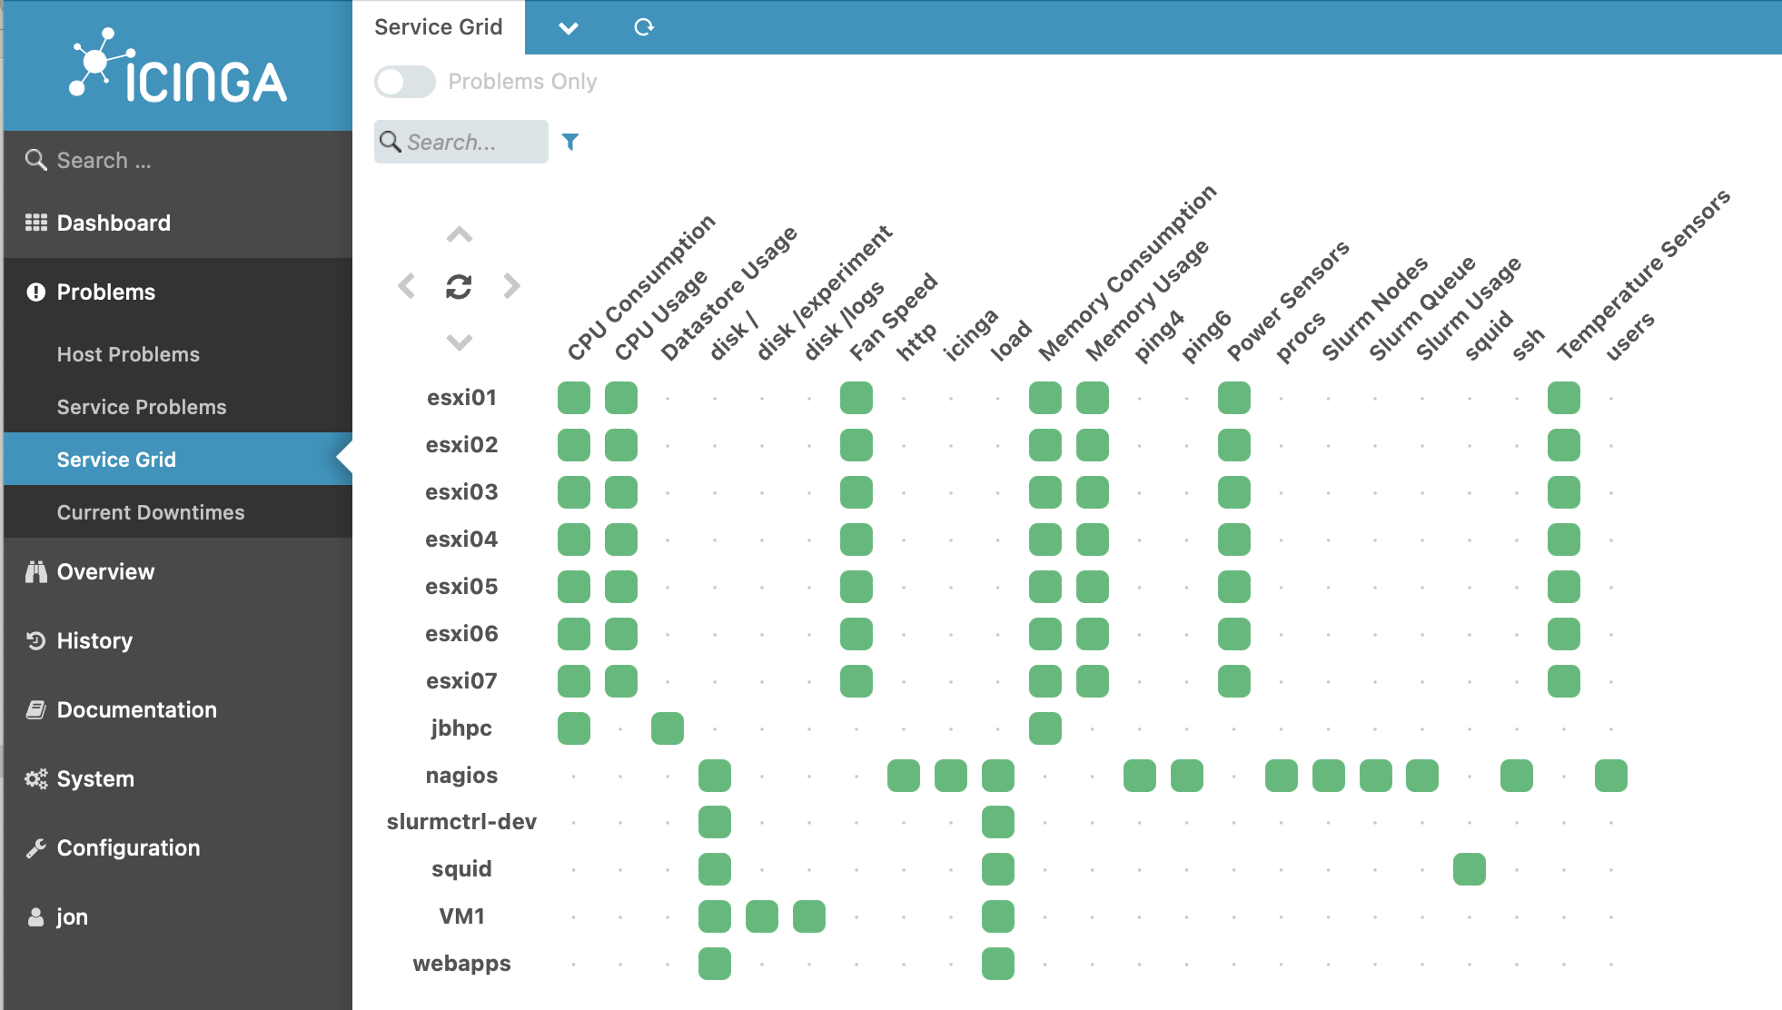
Monitoring services aggregate system status
Notes:
Once we decide the metrics to track, we can aggregate them into one place to see the overall system status. For example, here is a screenshot of the open-source monitoring platform called Iciniga (good luck pronouncing it, try Aye-Singa)’s “Service grid” overview, which shows all of the services that are being tracked, all of the KPIs that are being tracked, and the overall status of each KPI on each service

Slide 44
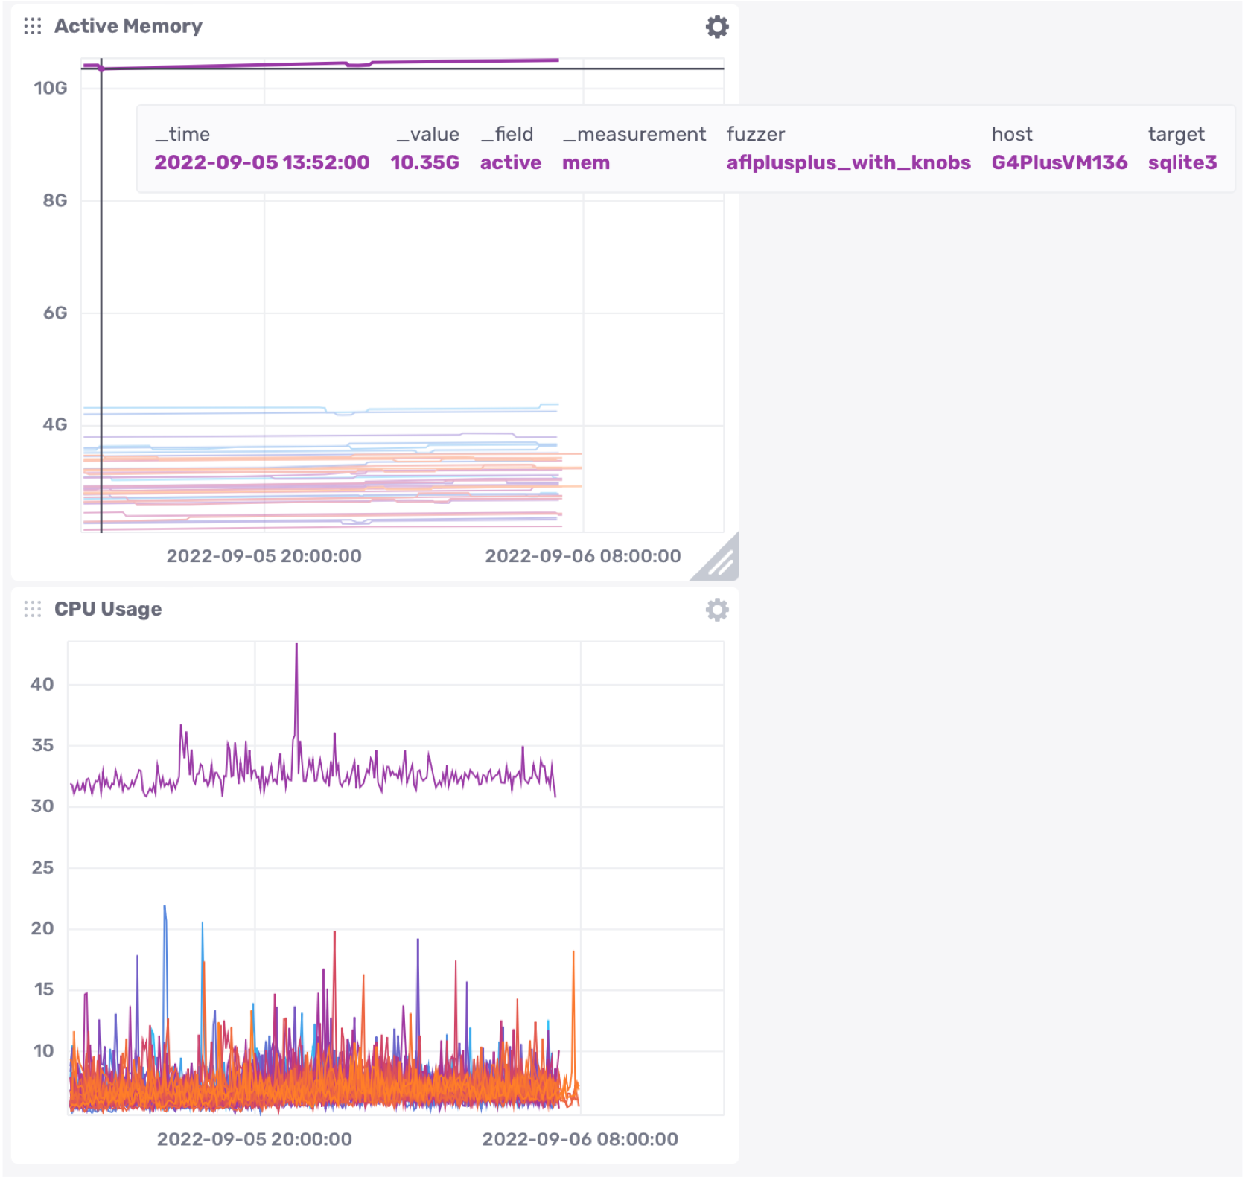
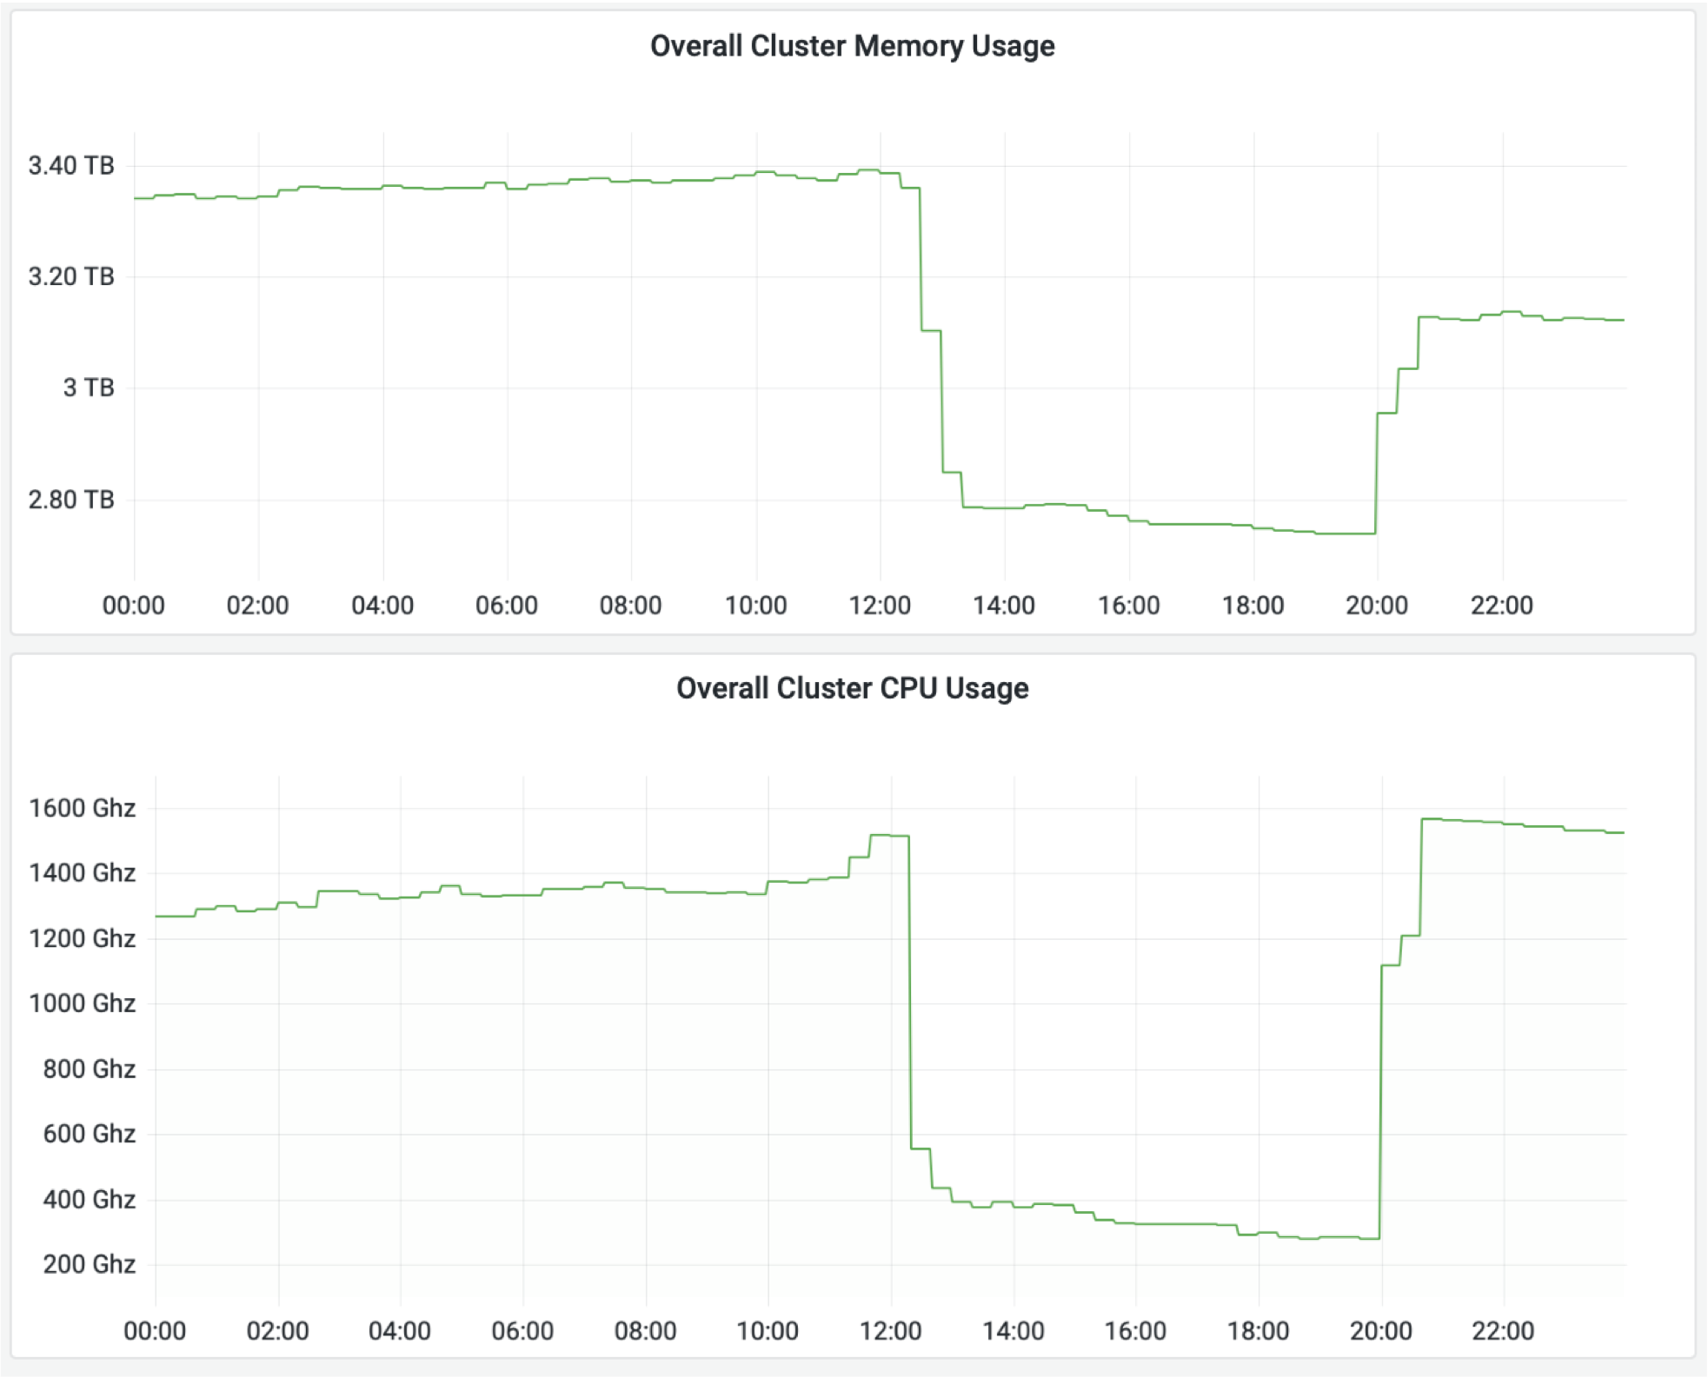
Monitoring dashboards help gather insights
Notes:
Dashboards that aggregate multiple KPIs into one place allow a human operator to gather insights by putting in one place all of the kinds of metrics that we just saw.
Once data like this is being tracked, it’s easier to gain high-level insights by plotting it and using an interactive interface to query it. This screenshot is taken from an open-source analytics and interactive visualization product called InfluxDB.
On the left, we can see some overall hardware metrics (memory and CPU usage). On the right, we can see a drill down that shows the actual memory and CPU usage for each of many different applications that are running concurrently. We can see that there is a single outlier application in both memory and CPU usage; in the top right screenshot we can see that this application is using 10.35GB RAM, running on host “G4PlusVM136” and running target “sqlite3”. This kind of information is useful for detecting potential performance regressions before they cause more significant problems.

Slide 45
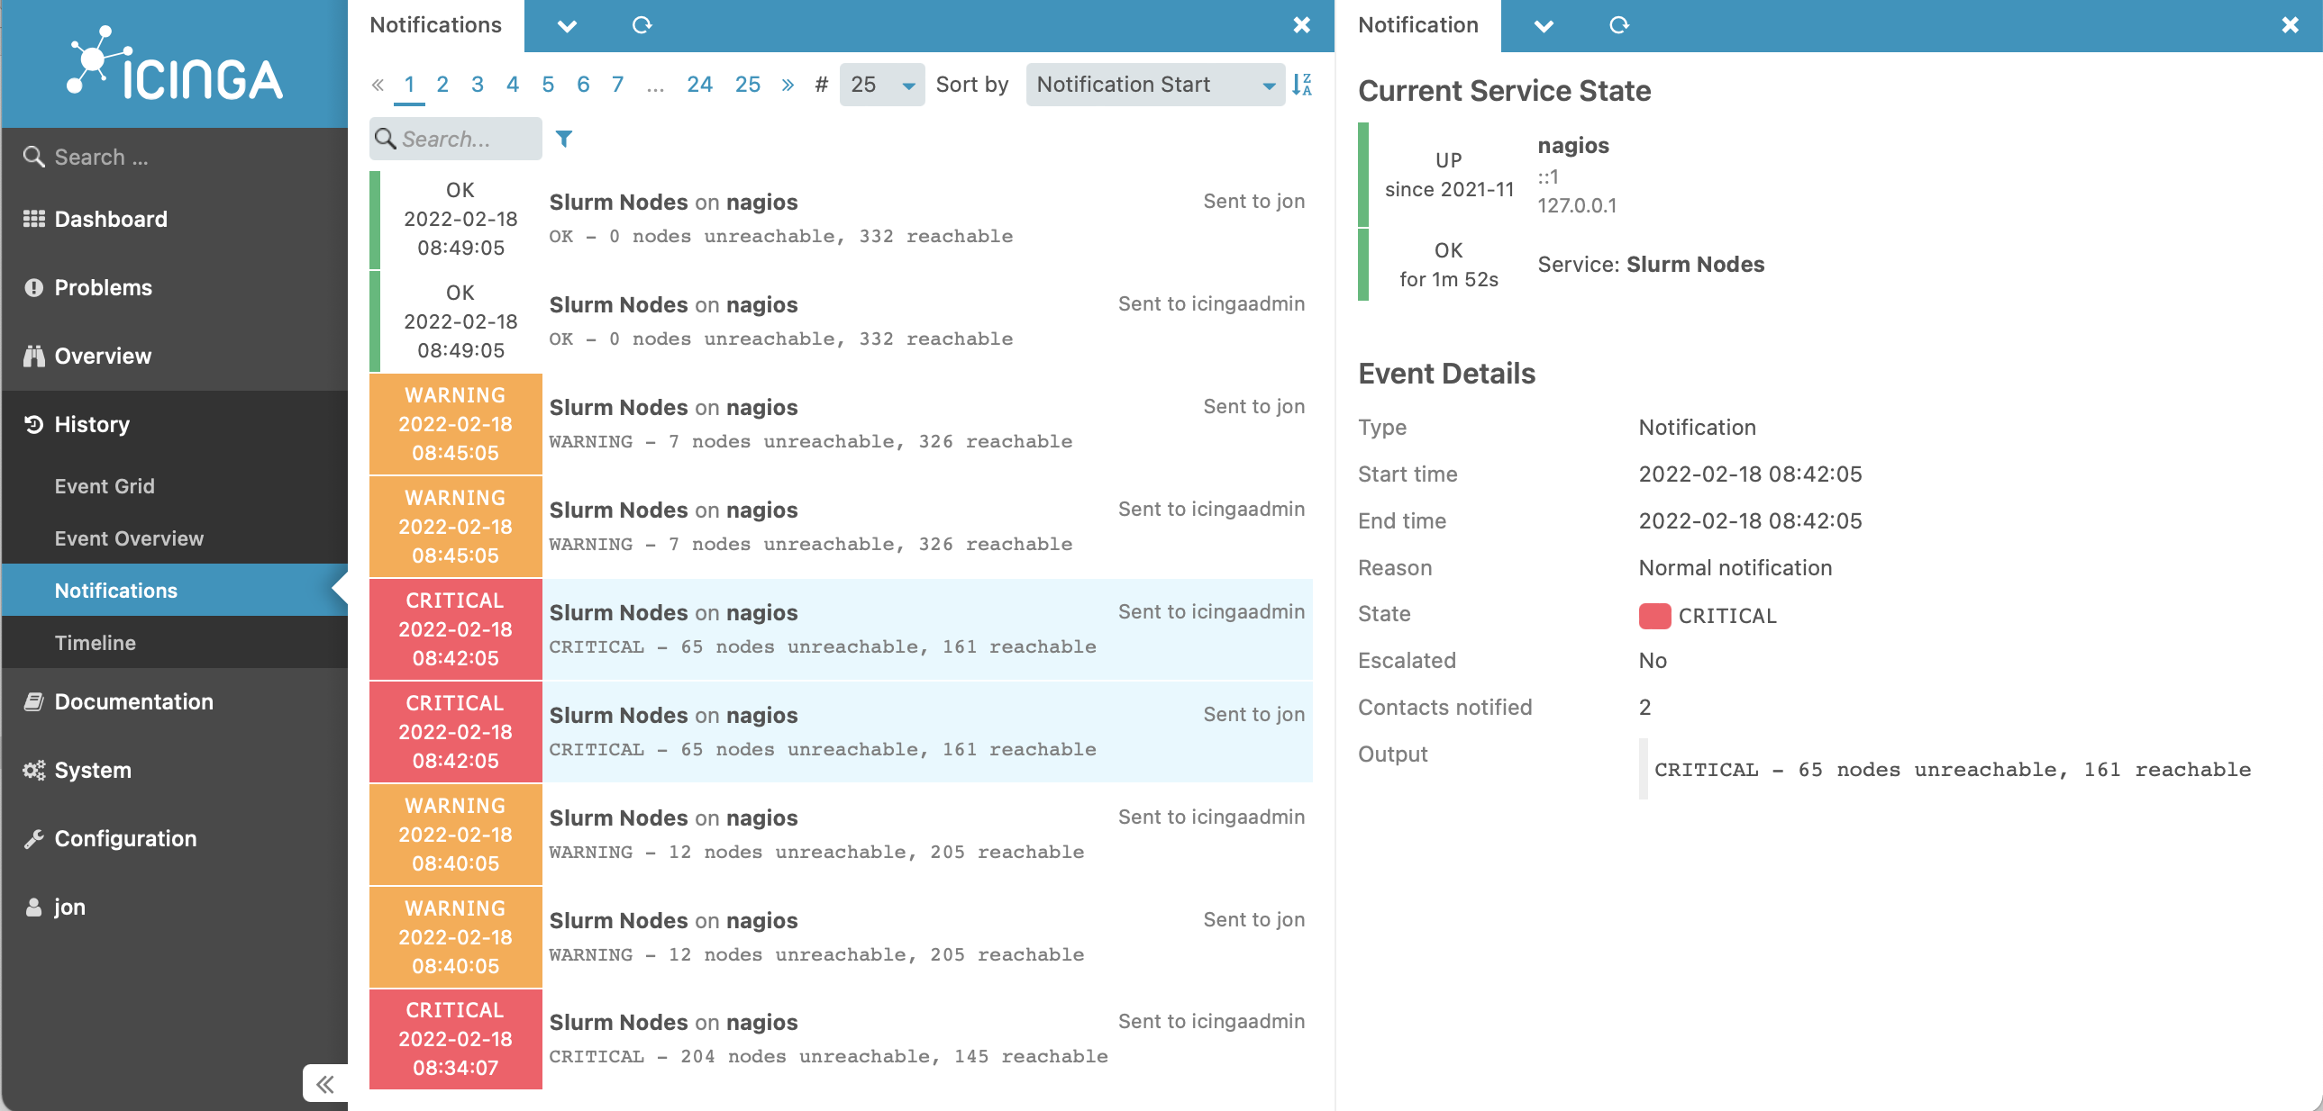
Monitoring services take automated actions
Notes:
Once we are monitoring these KPIs, it’s also possible to set up automated processes that take actions when certain events happen. Here’s a screenshot of another view of Icinga. One of the key kinds of actions that Icinga is designed to take is to simply track problems and run a series of escalating notifications to ensure that they get noticed and resolved. In this screenshot, you can see the various times that the “slurm nodes” application service degraded and then eventually entirely failed on Feb 18. Each entry shows a notification that was sent.

Slide 46
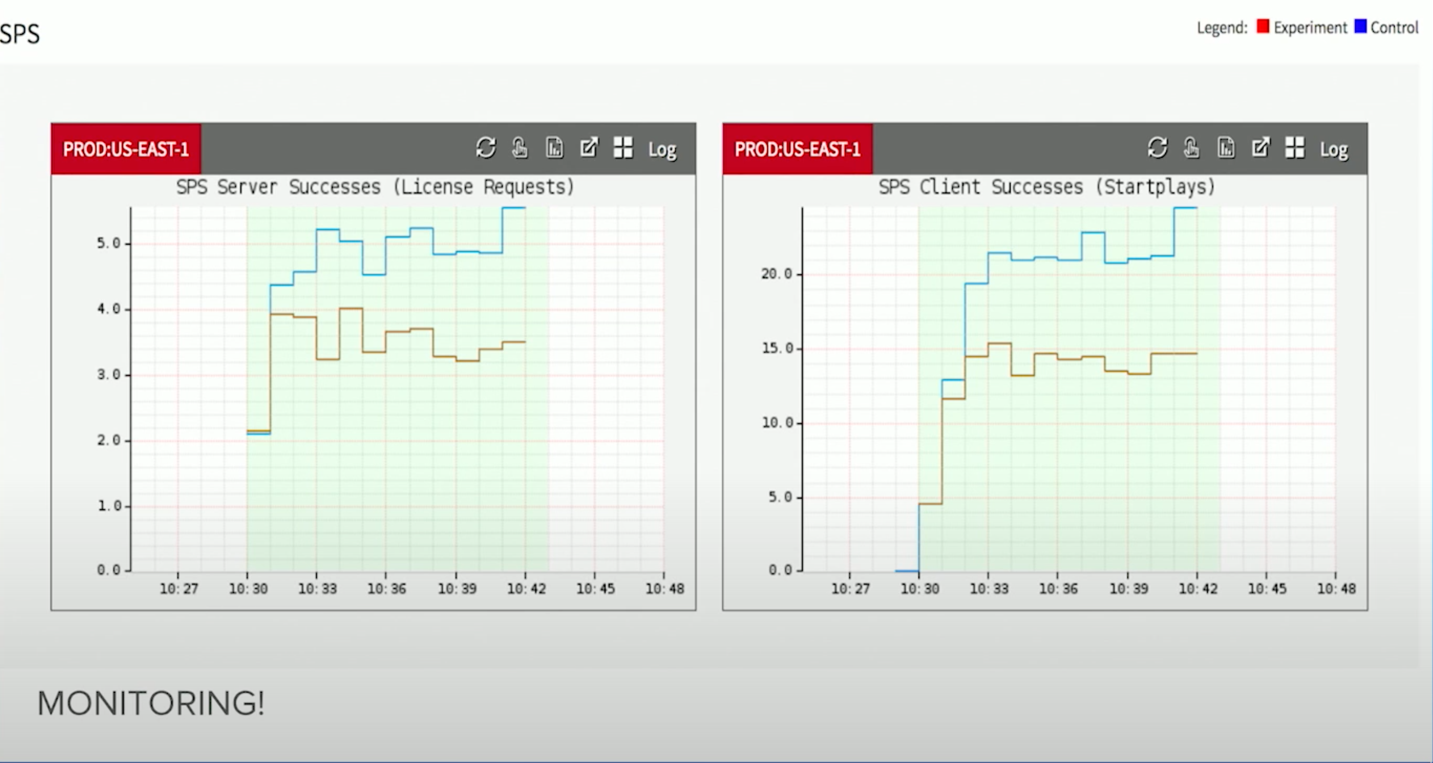
Monitoring services take automated actions
Automatically detecting irregular behavior at Netflix
https://www.youtube.com/watch?v=qyzymLlj9ag
Notes:
In a real production scenario, we probably want to automate even more of a response than simply sending a notification.
Here is an example of application-level monitoring in practice, from Netflix. These monitoring graphs plot SPS, which is Netflix’s key business metric: “Stream starts per second” - can a user actually watch what they want to watch.
Graph shows a comparison between a “control” group (running old version of software, blue) and an “experiment” group (running new version proposed, shown in red). If SPS deviates between control and expected, auto-rollback occurs within seconds; no manual intervention is necessary.

Slide 47
Usability testing in continuous development
A/B Testing
Ways to test new features for usability, popularity, performance without a focus group
Show 50% of your site visitors version A, 50% version B, collect metrics on each, decide which is better
Notes:
Once we have business-level metrics defined (like SPS/stream starts per second in Netflix’s case), we can even use these technologies to perform usability/acceptance testing.
The core idea to these kinds of tests is that it is possible to test how well a software product is providing business value.
(Read slide)
A traditional approach to perform this kind of testing is to run focus groups: try to recruit a representative sample of your customers, and then observe them using your product, ask them questions, etc in order to etermine how well it works for them. This is a relatively slow process, because you need to recruit a panel and run the study and analyze the results… and then try to draw insights from what might be a relatively small sample size. A/B testing lets you run tests comparing two implementations of a piece of software with your real users almost instantly.

Slide 48
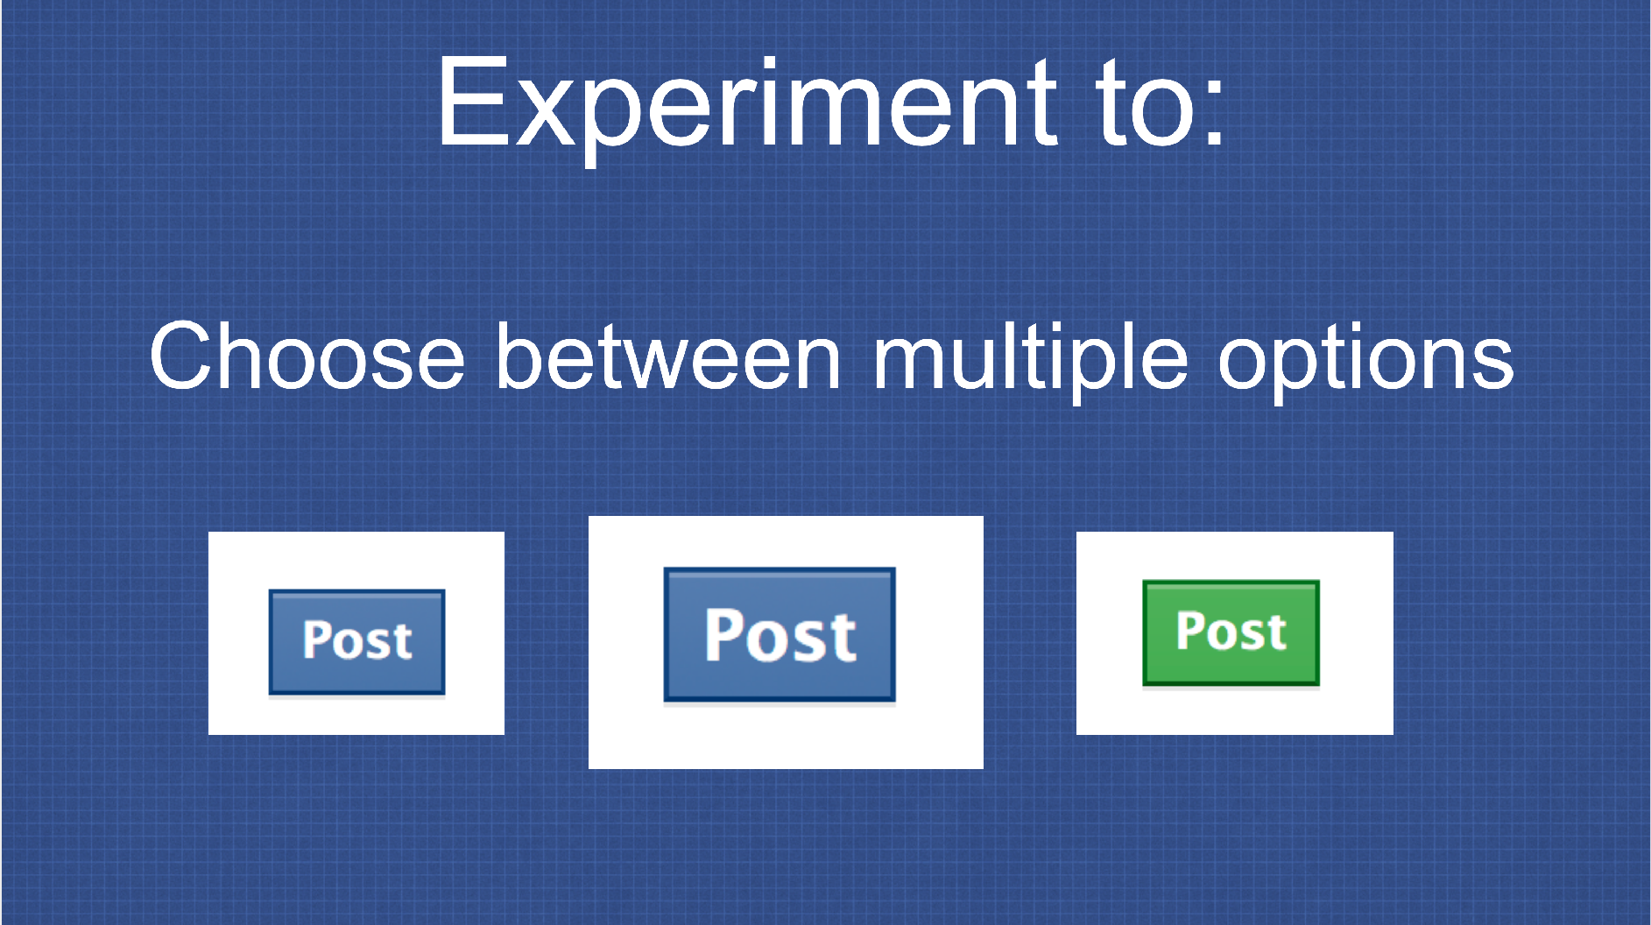
Usability testing in continuous development
A/B Testing: PlanOut from Facebook (“N=10⁹ user study”)
https://github.com/facebook/planout
https://www.slideshare.net/optimizely/opti-con-2014-automated-experimentation-at-scale
Notes:
Facebook scales this A/B testing approach to what they call a “N=10^9 user study (N=1 trillion)”. A/B testing is performed constantly at Facebook, and they even constructed an open source tool for doing so.
For example, this tool could be used to determine which of these three “post” buttons encourages users to post the most on Facebook. How do you know which will work the best? You could come up with some theories. Or, you could do a controlled study, where huge samples of users are shown these different options, their behavior is logged, and results are automatically analyzed.
One of the key features of this tool is to be able to automatically segment the audience (think about diverse users – would not want to for example only one variant to one population) and collect results
Basically doing a psychology experiment - try to avoid being evil (“show users sad posts, does that make them sad?”).

Slide 49
Usability testing in continuous development
A/B Testing: PlanOut from Facebook (“N=10⁹ user study”)
https://github.com/facebook/planout
https://www.slideshare.net/optimizely/opti-con-2014-automated-experimentation-at-scale
Notes:
Example for a quick experiment - divide people randomly, show different post buttons. Independent variable is color, size of button. Could try lots of combinations too.

Slide 50
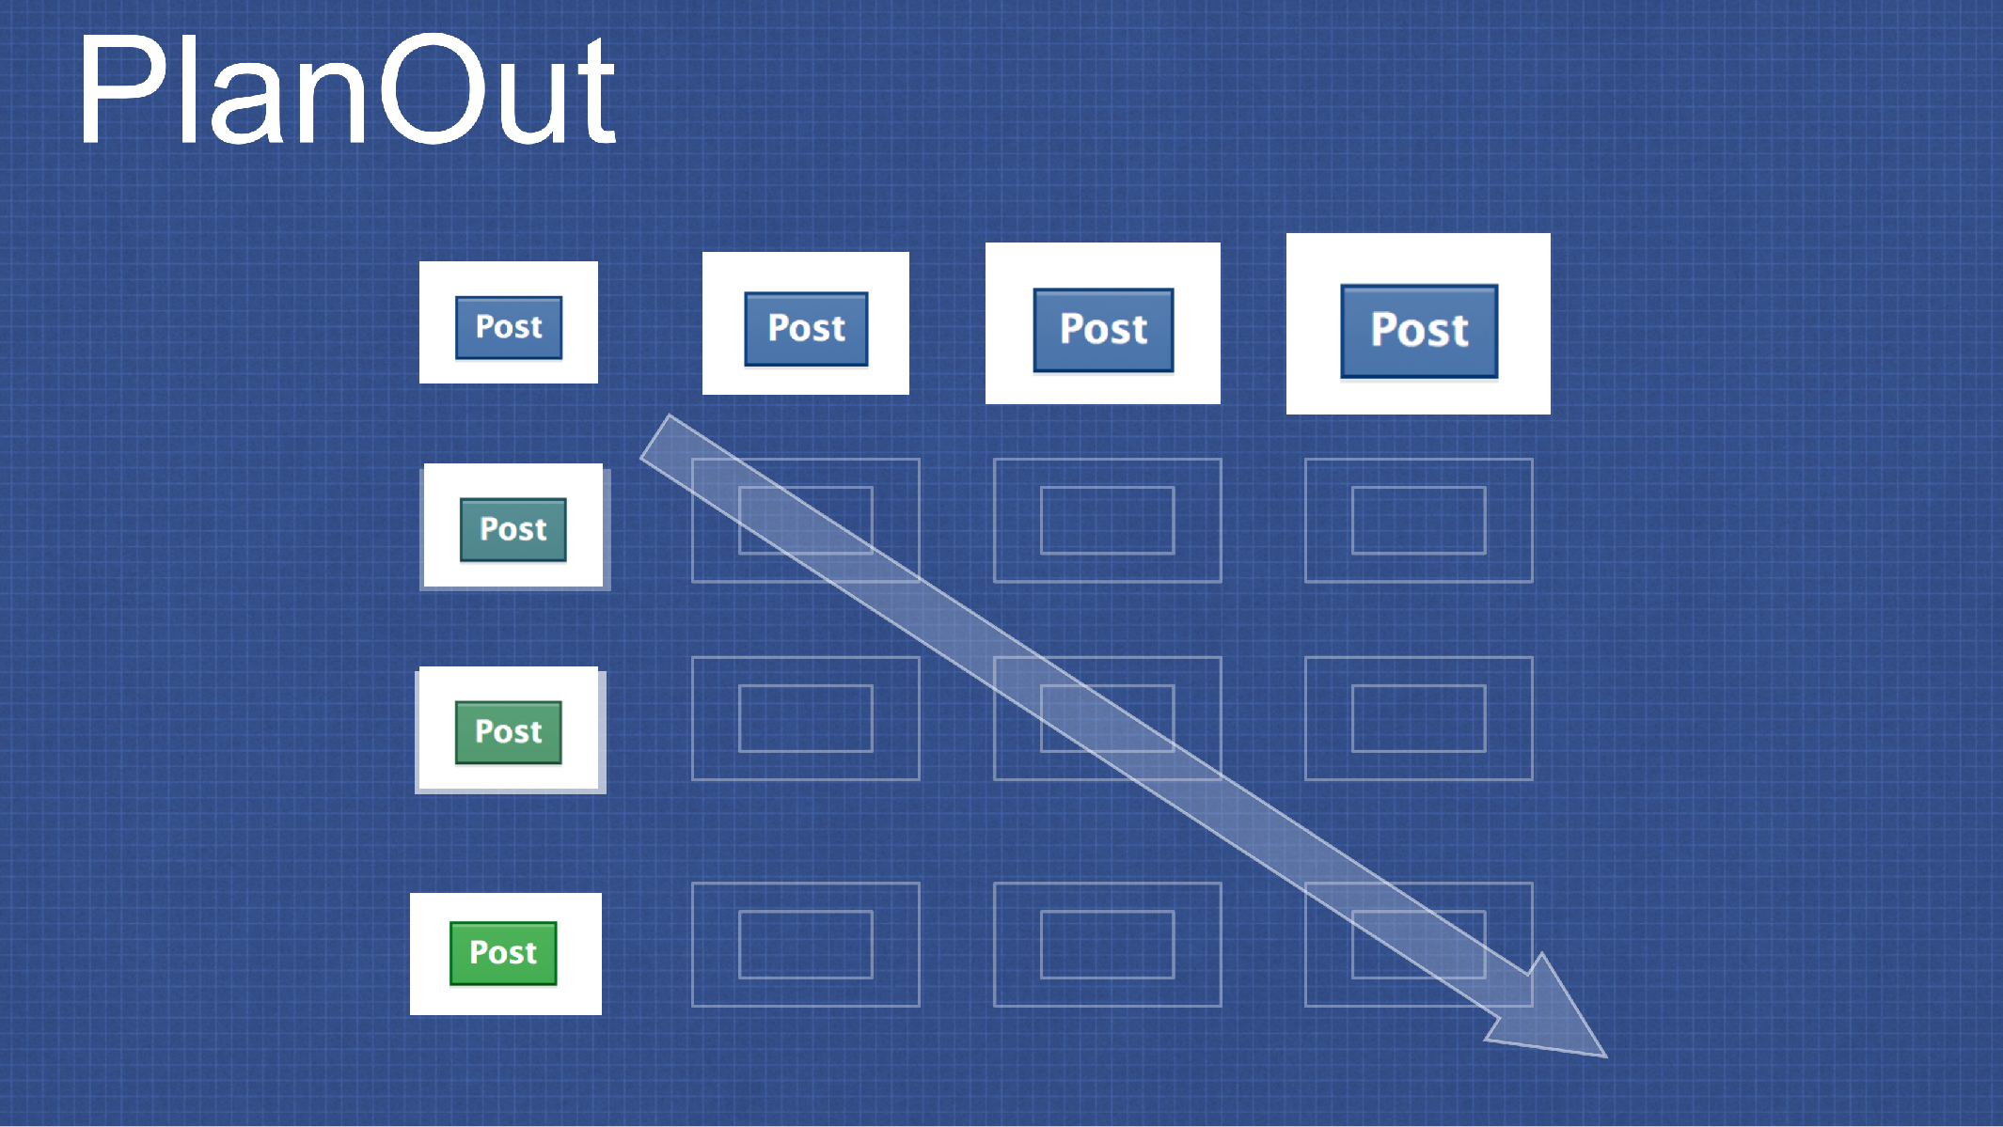
Usability testing in continuous development
A/B Testing: PlanOut from Facebook (“N=10⁹ user study”)
https://github.com/facebook/planout
https://www.slideshare.net/optimizely/opti-con-2014-automated-experimentation-at-scale
Notes:
Part of what is so neat about automating an experiment like this is that the software can automatically evaluate *many* design alternatives. For example, we could try all gradients of color from blue to green, and all gradients of size from small to large.

Slide 51
Usability testing in continuous development
A/B Testing: PlanOut from Facebook (“N=10⁹ user study”)
https://github.com/facebook/planout
https://www.slideshare.net/optimizely/opti-con-2014-automated-experimentation-at-scale
Notes:
Just like how we can use CI and monitoring to automate reporting of KPIs, reporting results of studies like this “does the bigger button get more clicks?” can be fully automated too.
The platform takes the exposures (what variants were shown) + metrics (what we are observing) and then evaluates our KPI (in this case, number of posts). This visualization shows that there was a slight decrease in the number of posts between the control (existing condition) and the proposed changed button

Slide 52
Beware of Metrics
McNamara Fallacy
Measure whatever can be easily measured
Disregard that which cannot be measured easily
Presume that which cannot be measured easily is not important
Presume that which cannot be measured easily does not exist
Notes:
When talking about quantitative metrics, it’s extremely important to consider how rigidly we follow them. Setting KPIs for monitoring is a very good idea, but not all important metrics can be easily measured quantitatively.
Robert McNamara was secdef in the 60’s, had previously been an executive at Ford where he made quantitative metrics for each phase of production and ruthlessly optimized to improve efficiency and production. Applied similar strategy to secdef… “Things you can count, you ought to count - loss of life is one” - so, based lots of strategy on body counts. Body count is one thing, but not the whole picture. After war ended in interviews, generals commented that body counts were misguided way to measure progress. Compare to: using LoC to track progress on a project… how do you even know how many lines there should be, and is it good to have a lot? Software metrics are very tricky because it it is hard to quantify everything.

Slide 53
What could Knight capital have done better?
Use capture/replay testing instead of driving market conditions in a test
Avoid including “test” code in production deployments
Automate deployments
Define and monitor risk-based KPIs
Create checklists for responding to incidents
Notes:
The Knight capital story is definitely an interesting one, and perhaps now that we have discussed some strategies for continuous deployment, it is hopefully somewhat clearer how this enormous financial loss could have been prevented.
First, some comments on the testing strategy:
Why, why why why is it a good idea to write a test case that actually tries to change market conditions, when you could instead test your code using simulated/historical market conditions?
Never include testing code in production deployments: that test code for changing markets in order to test the system response to them was included in the production code!?!
Then on the deployments:
If deployment were automated, there would not be a step for an engineer to miss on one of the 8 deployments: they could always happen predictably
There was insufficient monitoring. The way that this error was detected was the NYSE had noticed that market volume was more than expected, and then traced it back to Knight. Nobody at Knight had thought to create a dashboard that monitored their volume (and perhaps more importantly, financial exposure vs assets at hand). This could have been detected *immediately* and automatically paged the relevant people (and perhaps also automatically paused the firm’s trading activities). Seems like a reasonable investment.
There were no checklists for responding to incidents, and no procedures to roll-back if needed. “If in doubt back it out” was the Facebook philosophy, and it requires a process to be in place so that it can be easily triggered

Slide 54
Review
By now, you should be able to…
Describe how continuous integration helps to catch errors sooner in the software lifecycle
Describe the benefits of a culture of code review
Describe strategies for performing quality-assurance on software as and after it is delivered

